Slide 1
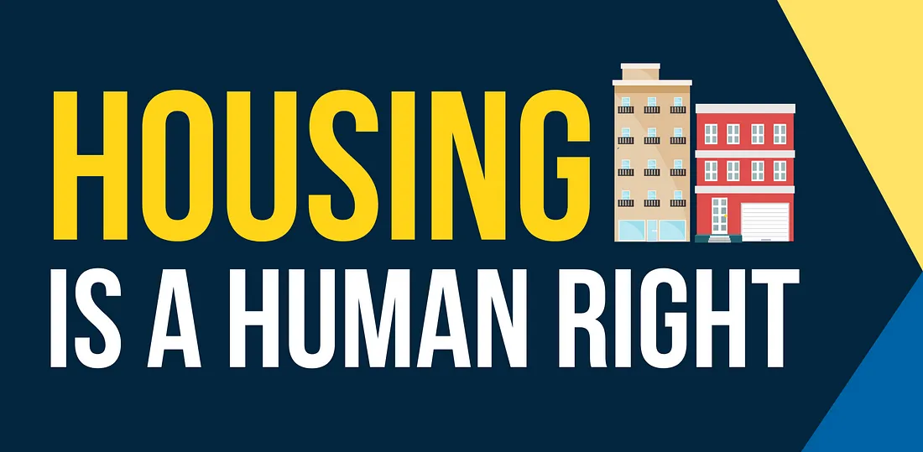
Housing First 101
What is Housing First?
Housing First is grounded in human rights principles.
Housing First is grounded in religious and moral traditions—including in the U.S.
Housing First applies to all housing-insecure people.
Housing First works.
Housing First is under threat.

Slide 2
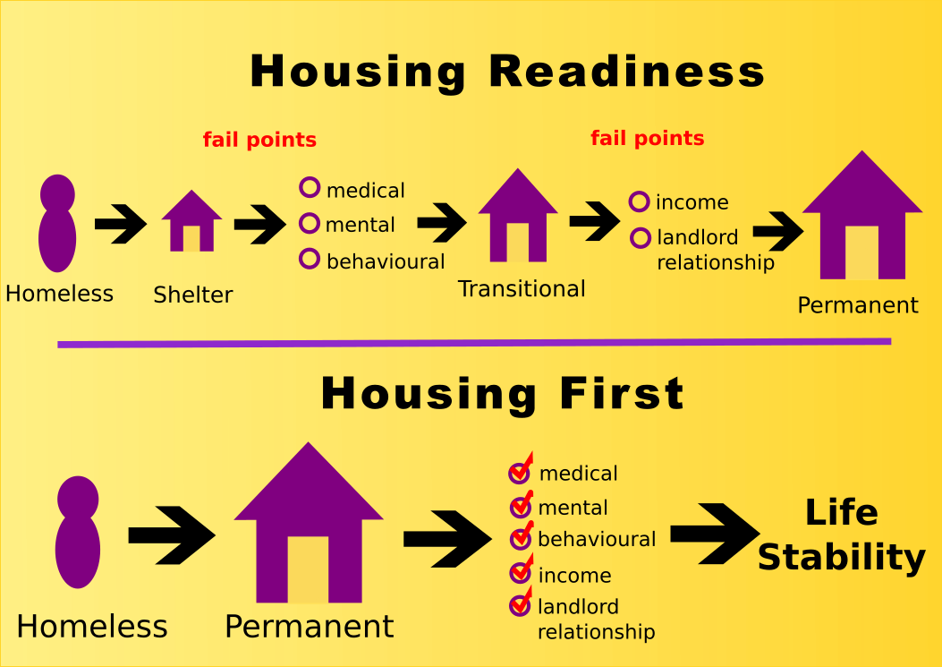
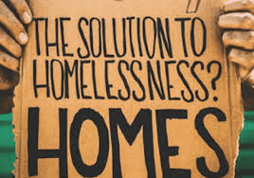
What is Housing First?
Housing First provides unconditional, permanent housing as quickly as possible to people, and other supportive services as needed afterward.

Slide 3
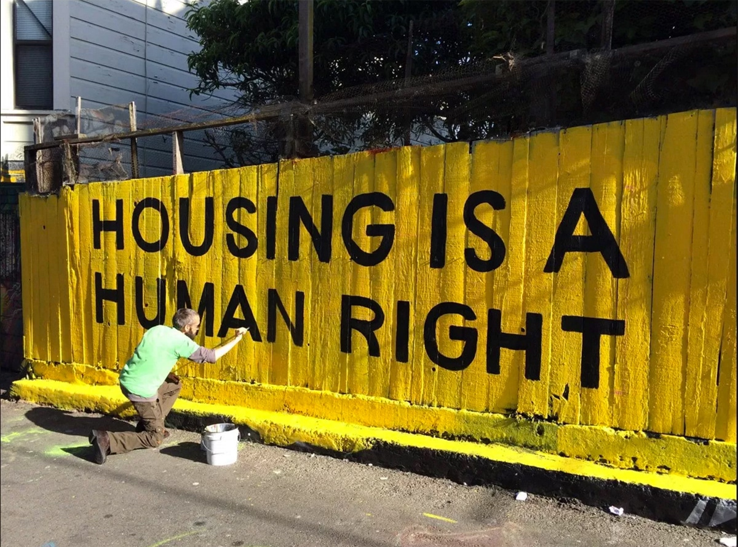
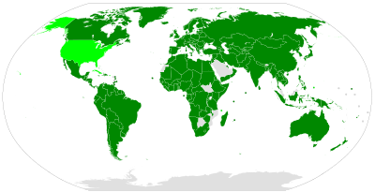
Housing First is Grounded in Human Rights Principles
FDR 1944 “Second Bill of Rights” (“The right of every family to a decent home” →
UDHR, Art. 25, 1948 (“Everyone has the right to a standard of living adequate for the health and well-being of himself and of his family, including . . . , housing”) →
ICESCR, Art. 11 (“The right of everyone to an adequate standard of living . . including adequate . . . housing”)—171 parties
Many nations have right to housing in their constitutions or legislation—and act on it (ex: Finland, South Africa, The Netherlands)
Housing Assistance = Entitlement, a la SNAP/Food Stamps, Medicaid (ex: Australia, UK)

Slide 4
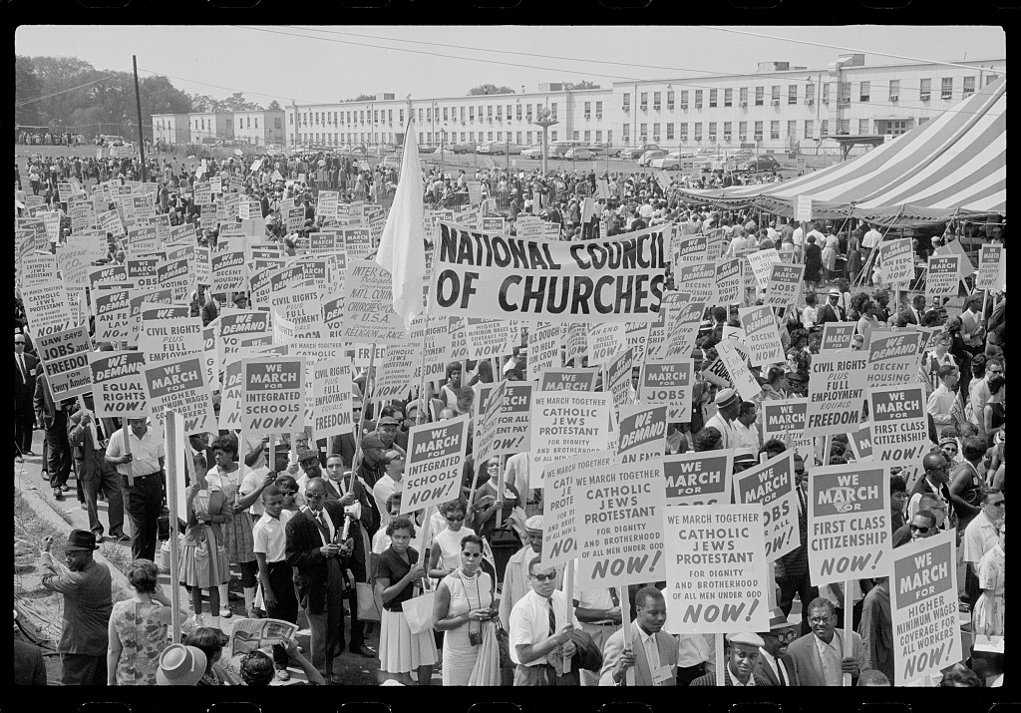
Housing First is Grounded in Religious and Moral Traditions . . . . Including in the U.S.
Obligation of “hospitality” to the poor and homeless, is core of every major religious and ethical tradition
Pre-1980’s US: public investment in affordable housing high, homelessness was rare
Polls: three-quarters of Americans believe that adequate housing is a human right
American Bar Association, American Public Health Association, lawmakers including Pres. Biden: Housing is a human right

Slide 5

Housing First Applies to All Housing-Insecure People
UC San Francisco study, largest in the past 30 years: Homeless persons’ median income the month before they became unhoused was only $960
U.S. Government Accounting Office: For every $100 in average rent increases, there is a 9 percent spike in homelessness
“Housing costs explain far more of the difference in rates of homelessness than variables such as substance use disorder, mental health, weather, the strength of the social safety net, poverty, or economic conditions” : Pew Charitable Trusts analysis of academic research

Slide 6
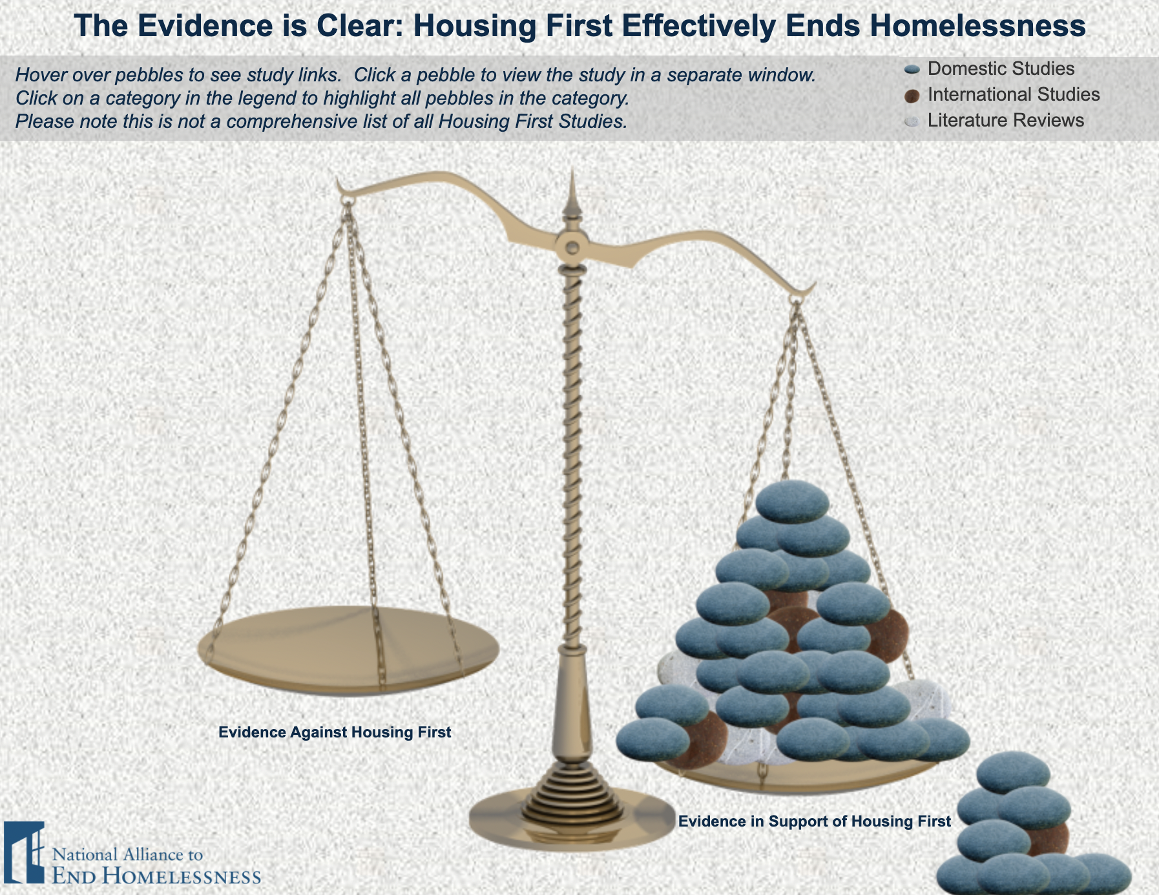
Housing First Works
From Houston to Helsinki: sharply reduces # of unhoused, cuts government costs
Dramatic success w/ veterans: Adam Musters, MSW, 3L
President Trump’s first HUD secretary (Dr. Ben Carson): “we can say without hesitation that we know how to end homelessness”

Slide 7
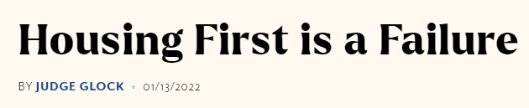



Housing First is Under Threat
From the people who brought you the Critical Race Theory straw men
“With friends like these . . .”—Supposed Housing First cities/programs cutting corners and undermining the model
Threats from criminalization, etc.: Attorney Siya Hegde, National Homeless Law Center

