Slide 1

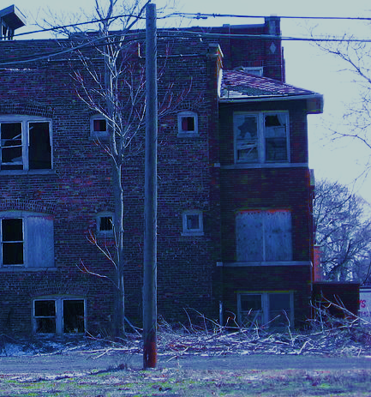
Public and Private Habitability Enforcement Mechanisms in Indiana
IU McKinney Health and Human Rights Clinic
Jacob Purcell, B.A., J.D. Expected 2024

Slide 2
Tragic Case Study: Lakeside Pointe
Northside housing complex home to predominantly low-income tenants, some being refugees
More than 3,000 housing code violations over five years
Unit with twenty past code violations caught fire, displacing at least twenty-five residents
Research Question: How was the possible?

Slide 3
The Problem: Substandard Housing in Indiana
Comprehensive data rare or nonexistent
Current ACS data conveys aging rental housing stock
Forty-two percent of Indiana’s rental housing units constructed prior to 1970
In 31 of Indiana’s 92 counties, over 50% of rental units, were constructed prior to 1970
2012 American Housing Survey – Indy Area alone
13,100 rental units with mold
27,000 had signs of rodents
12,00 had signs of cockroaches
14,400 had open cracks or holes

Slide 4
Socioeconomic Vulnerabilities of Tenants
Common refrain: “If conditions are so bad, why haven’t you left?”
Reality: tenants cannot feasibly move from dangerous housing, due to both economic trends and socioeconomic factors
Socioeconomic factors:
IN tenants are almost six times more likely to be below the poverty level than homeowners
Nearly one-third of IN tenants have a child
Tenants cannot find housing due to poor credit, criminal convictions
Large economic trends:
Increasing number of tenants seeking rental housing
Diminishing proportion of affordable rental units
Declining vacancy rates for rental properties

Slide 5
Dangerous Housing and Evictions: the Connection
Both evictions and code violations are disproportionately perpetrated by large, institutional, out-of-state landlords.
IndyStar in 2018: Large, institutional landlords accounted for 88 percent of evictions in Indianapolis
One third of the top 100 evictors were located out-of-state
SAVI in 2020: properties with more complaints had exponentially more evictions per capita:
Number of Complaints | Eviction Filings | Properties | Eviction Filings per 100 Properties
Zero complaints | 4,039 | 74,286 | 5
1-2 complaints | 1,825 | 2,006 | 91
3-9 complaints | 2,154 | 459 | 469
10+ complaints | 2,336 | 93 | 2,512

Slide 6
The Implied Warranty of Habitability
Javins v. First National Realty Corp. (D.C. 1970)
All states have recognized IWoH, except Arkansas
National Comm. for Uniform Laws drafted the Uniform Landlord Tenant Act. Section 2.104(a) lays out landlords' responsibilities:
(1) complying with building and housing code requirements materially affecting health and safety, (2) make all repairs and do whatever is necessary to put and keep the premises in a fit and habitable condition, (3) keep common areas clean and safe, (4) maintain in good and safe working order and condition facilities and appliances supplied or required to be supplied by the landlord, (5) provide and maintain receptacles for waste and arrange for their removal, and (6) supply running water and reasonable amounts of hot water and heat.
Q: Even Indiana?
A: Yes. But we still have two major barriers:
Our habitability statute is incomplete
The bifurcated eviction procedure

Slide 7
Indiana’s Habitability Statute and its Omissions
Landlord Tenant Act (P.L. 92-2002)
Three substantive provisions:
Landlord must deliver premises in “safe, clean and habitable condition” and “comply with all health and housing codes applicable”
Landlord cannot waive these requirements – leases that do are void
Tenants could bring a civil action following notice and a “reasonable” time for cure, to recover “actual and consequential damages, injunctive relief, and attorney’s fees.”
Three major omissions:
Many courts require expert witnesses to prove actual damages
Did not state that tenants’ payment of rent and landlords’ duty to provide habitable condition are dependent covenants
No right for tenants to withhold rent in any capacity

Slide 8
Indiana’s Bifurcated Eviction Procedure
Indiana’s bifurcated eviction procedure often prevents tenants from raising habitability-related claims until they have already lost possession of their home
Unconstitutional, because it violates the Due Process Clause of Indiana’s Constitution (Art. 1, Sec. § 12)
For see more detail, see panelist Professor Roisman’s excellent law review article:
Florence Roisman, Indiana Landlord-Tenant Law: An Important Step Forward in Theory Needs to Be Made Real in Practice, 53 Ind. L. Rev. 317 (2020).
Eviction Claim
Usually filed in township or small claims court
Possession Hearing
Usually decided in favor of landlord if tenant does not pay their rent
Possession Order for Landlord
Weeks later, after tenant has lost possession
Damages Hearing
Usually decided in favor of landlord if tenant does not pay their rent
Tenant can prove damages

Slide 9
The Problem:
Unlike almost all other states, Indiana does not grant tenants a clear right to withhold rent.

Slide 10
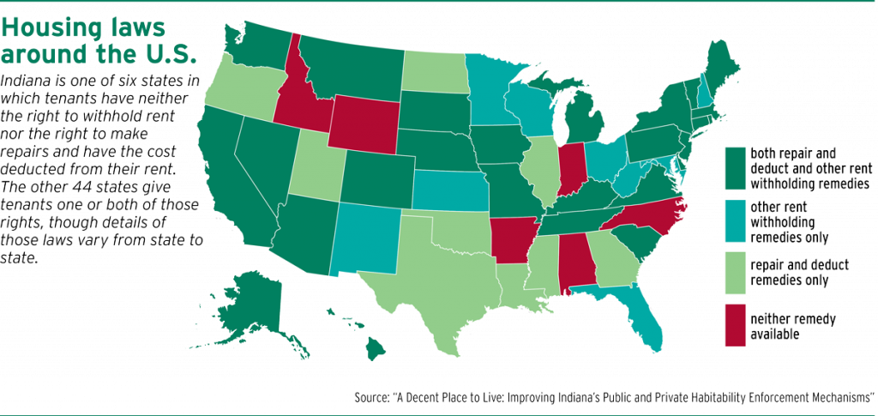
Rent Withholding Map
Map Credit: The Indiana Lawyer

Slide 11
Rent Withholding Remedies: Variations
Repair and deduct remedies – allow tenants to repair conditions themselves, then deduct that amount from their rent
Can either be statutory or common law (e.g., Indiana)
Usually have upper limits to statutory remedy (ex: up to $1000)
Other rent withholding laws – allow tenants to withhold rent following notice of conditions

Slide 12
Example Repair and Deduct Law: South Dakota
43-32-9. Failure of lessor to repair premises--Lessee's remedies.
If within a reasonable time after notice to the lessor of conditions requiring repair to make the premises fit for human habitation and to place the same in good and safe working order which the lessor ought to repair he neglects to do so, the lessee may repair the same himself and deduct the expense of such repairs from the rent, or otherwise recover it from the lessor; or the lessee may vacate the premises, in which case he shall be discharged from additional charges of rent or performance of other conditions.
. . .
Source: CivC 1877, § 1115; CL 1887, § 3738; RCivC 1903, § 1434; RC 1919, § 1058; SDC 1939, § 38.0410; SL 1976, ch 267, § 5.
1
2
3

Slide 13
Variations in Repair and Deduct
Law Type | States
Uniform Residential Landlord Tenant Act (URLTA) | Both URLTA § 4.103 and URLTA § 4.101(a): Arizona, Kentucky, Montana, Nevada, Oklahoma, Oregon, and Rhode Island
 | Only URLTA § 4.101(a): Alaska, Connecticut, Iowa, Nebraska, South Carolina, and Tennessee
Other Repair and Deduct Statute | California, Colorado, Delaware, Hawaii, Illinois, Louisiana, Maine, Massachusetts, Montana, Mississippi, Missouri, North Dakota, South Dakota, Texas, Utah, Virginia, and Washington
Common Law Repair and Deduct | Michigan, New Jersey, New York, Pennsylvania, and Georgia
No Repair and Deduct Remedy | Alaska, Arkansas, Florida, Idaho, Indiana*, Kansas, Maryland, Minnesota, New Hampshire, New Mexico, North Carolina, Ohio, West Virginia, Wyoming, and Wisconsin

Slide 14
Variations in other types of Rent Withholding
Today, rent escrow provisions predominate
Escrow: tenants deposit rent into the court, which releases rent to landlord following improvement of conditions
Affirmative versus defensive rent escrow
Defensive
Affirmative
Rent abatement – when conditions are noncompliant, rent obligation is reduced to reflect diminution in present
Liquidated damages: statutory damages automatically apply (Delaware and New Mexico)
Court-based: court may reduce rent amount (WI and ME)

Slide 15
Factors Limiting Efficacy of Rent Withholding
Arduous notice requirements in statutes
Lack of counsel
Judicial Skepticism
“Ultimately [the landlord] going to get possession of the property. So I would suggest to you that you make some agreement with him to pick a date certain to move out . . . That's just where we are [sic] . . . I mean [the landlord] isn’t making this up. He’s a substantial citizen. He’s not making this up.” Morton v. Ivacic, 898 N.E.2d 1196, 1997 (Ind. 2008).

Slide 16
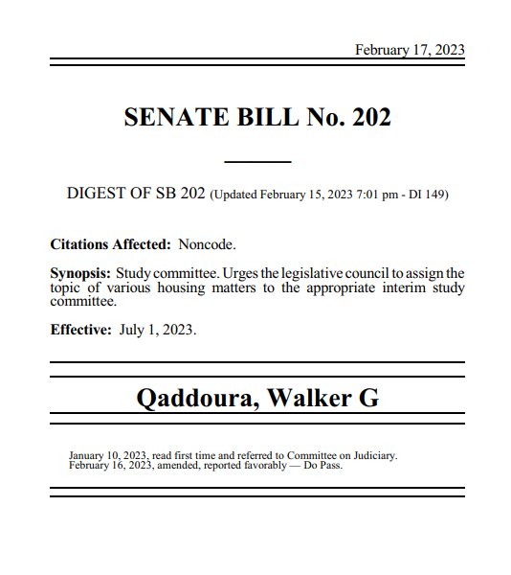
Recent Indiana Legislative Efforts on Rent Withholding
Senate Bill 230 (2022): Repair-and-deduct bill
House Bill 1148 (2023): Rent escrow and repair-and-deduct
Senate Bill 202 (2023): Affirmative-style rent escrow provisions, with rent escrow elements

Slide 17
Best Practices for Rent Withholding Statutes
Codify tenants’ rights via statute
Pass both repair and deduct and rent withholding laws
Create high monetary limit for repair and deduct claims, pinned to rent
Statutory damages to remove burden of proving damages
Minimize burdensome procedural requirements
Integrate code enforcement systems into rent withholding statutes
Good example: In Hawaii, if a government inspector identifies safety violations, the tenant may immediately use repair and deduct remedy.
Bad example: In Minnesota, tenant may only pursue rent escrow if conditions are first certified by a code enforcement agency

Slide 18
Public Enforcement Methods: An Overview
States have inherent police power to regulate housing, whereas municipalities generally have only the powers allocated by state law
Public enforcement usually occurs at the municipal level
Code Enforcement
Usually conducted at municipal level
Remedies include monetary fines and injunctive relief
Abatement – gov’t hires contractors to fix properties directly
Receivership – gov’t appoints agent to supervise fixing of property
Public Litigation – Government entity sues individual landlords under nuisance or consumer protection statutes

Slide 19
Indiana’s Public Enforcement Methods
Indiana’s Unsafe Building Law (IC § 36-7-9)
Authorizes monetary sanctions, abatement, and receivership
No proactive powers – municipalities cannot take action until there is an active hazard present on properties
Public Nuisance
Codification of common law
Considerably weakened following passage of Public Law 266-2017 (codified as IC § 32-31-1-22) the decision in City of Indianapolis v. Towne & Terrace Corp., 106 N.E.3d 507, 509 (Ind. Ct. App. 2018)
Local Housing Code Enforcement
Enforcement of local ordinances or housing codes
Enforced by municipal entities – (e.g., Marion County Public Health Department)

Slide 20
Proactive Rental Inspection Programs
Inspections as a prerequisite for leasing unit
Takes burden of reporting away from tenant
Indiana tenants, rightfully fear retaliation from landlords
IC 32-31-8.5 does not have a presumption of retaliation, putting burden of proof on tenants
Indiana Exemplar: South Bend’s Rental Safety Verification Program

Slide 21
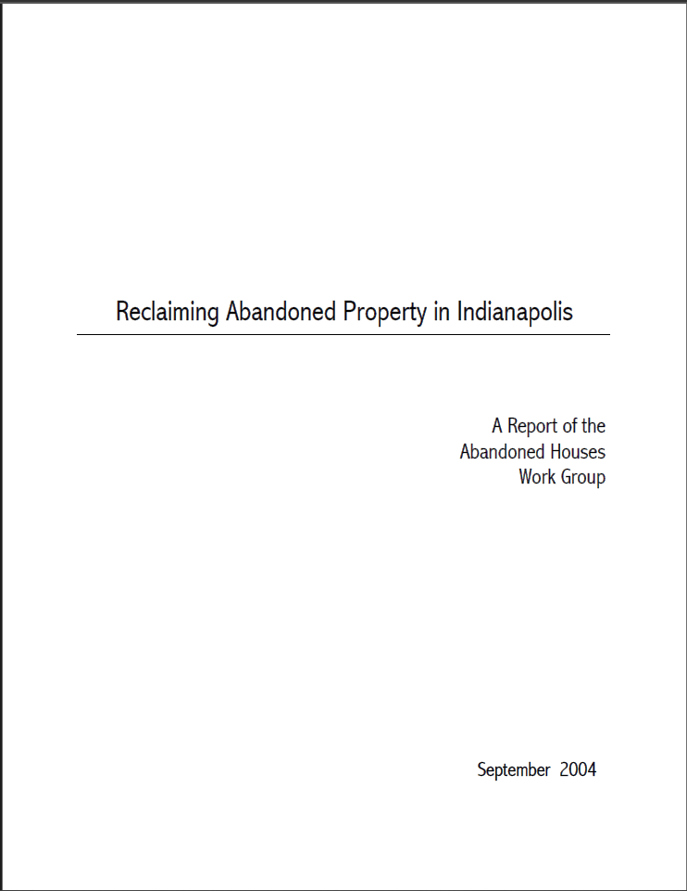
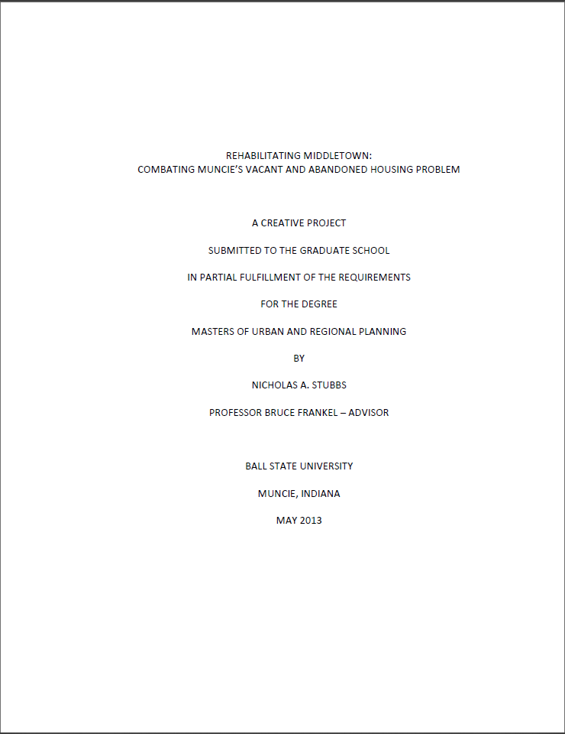
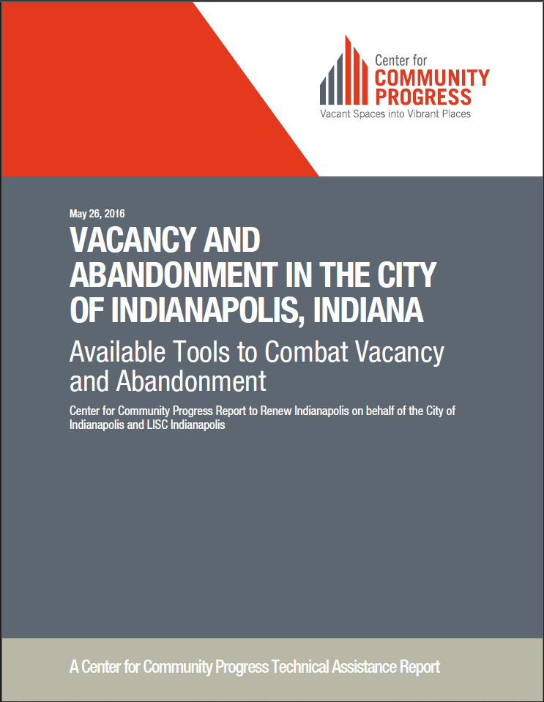


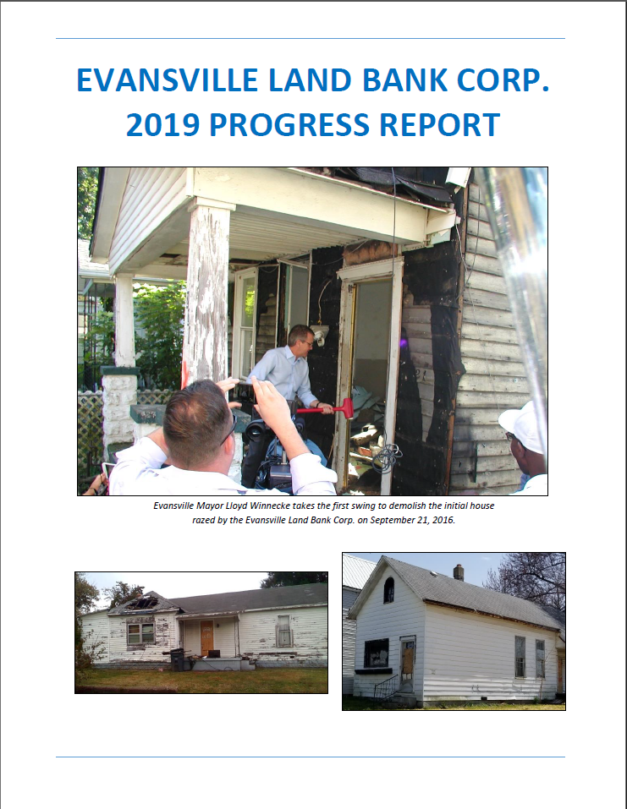
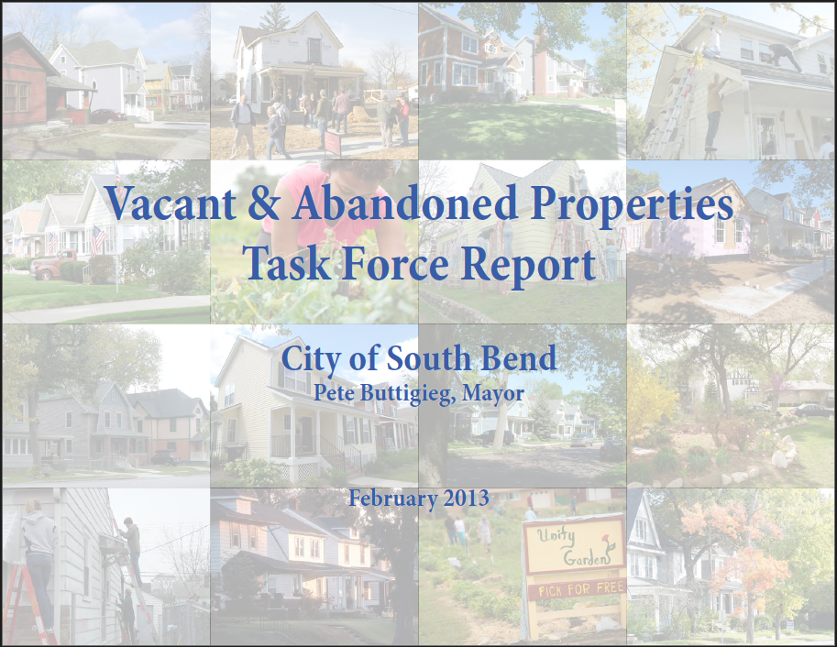
Public Enforcement Methods: Priorities
Municipalities try hard to combat dangerous housing,
until tenants are living in it.

Slide 22
Best Practices for Public Habitability Enforcement
Prioritize resources to combat dangerous rental housing
Promote proactive code enforcement programs
Clarify Indiana’s public nuisance law following the 2018 Town & Terrace decision
Utilize the full potential of Indiana’s Unsafe Building Law
Put tenants’ issues at the forefront of public solutions to dangerous housing

Slide 23
Closing Thoughts
Indiana tenants deserve a right to withhold rent
Rent withholding statutes and comprehensive code enforcement can only get us so far – tenants we need revolutionary change
We still need comprehensive policies to:
house the unhoused through investment in transitionary housing programs
divert individuals from eviction courts through mandatory diversion programs
exponentially increase the supply of affordable housing
stop the criminalization of homelessness
Rent withholding policies are merely one facet of a comprehensive housing solution

