Slide 1

Admitting We Have a Problem
Lead Testing in Indiana
Jennifer Phillips, J.D.
October 27, 2023

Slide 2
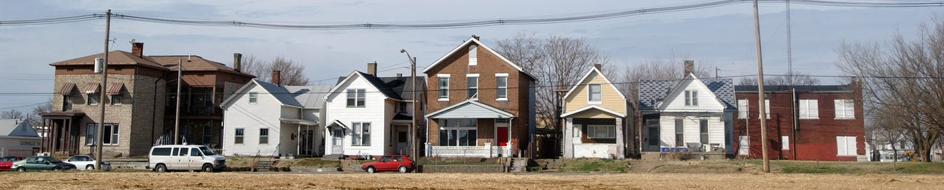
A Public Health Problem…
Leaded paint dust, soil, and water are the most common sources of lead exposure.
Over 1.5 million homes - over half of Indiana’s housing stock - were built before lead-based paint was banned.¹
Indiana is home to 22 EPA Superfund sites containing lead.²
Jacobsville Neighborhood Superfund site in Evansville, Indiana. Image Credit: https://www.courierpress.com/picture-gallery/news/2019/06/26/gallery-jacobsville-neighborhood-super-fund-site-lead-cleanup-years/1572602001/ (June 26, 2019).

Slide 3

A Public Health Problem…
1923 advertisement; Image credit: https://www.collectorsweekly.
com/articles/the-top-10-most-dangerous-ads/ (last visited Oct. 12, 2023).

Slide 4
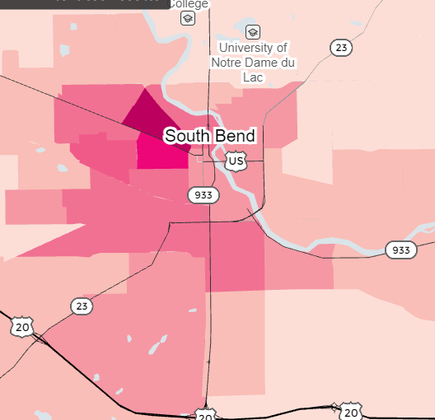
A Public Health Problem…
Over 25% of children tested had BLLs of 5µg/dL or more in some Indiana communities.³
$262 million is lost each year in Indiana due to childhood lead poisoning.⁴
An average of 2.6 IQ points per U.S. adult were lost due to the use of leaded gasoline.⁵
Looking for Lead, https://www.reuters.com/investigates/graphics/lead-water/en/ (last accessed Oct. 12, 2023).

Slide 5
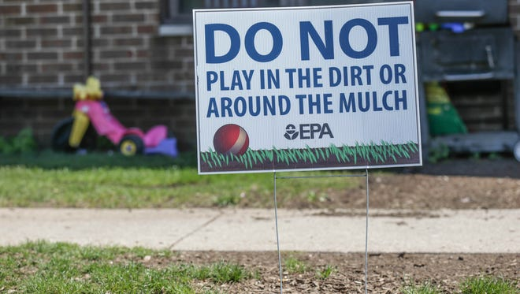
…Repeatedly Ignored
        Image Credit: Lead Pollution Forcing East Chicago Housing Complex Residents to Move, IndyStar, https://www.indystar.com/picture-gallery/news/2016/08/22/lead-pollution-forcing-east-chicago-housing-complex-residents-to-move/89123242/

Slide 6
…Repeatedly Ignored
“This pattern of government and societal complacency is apparent across the country and evidenced in the lead poisoning of over half a million children between one and five years of age today.”
          – Emily Benfer, in “Contaminated Childhood: How the United States Failed to Prevent the Chronic Lead Poisoning of Low-Income Children and Communities of Color”⁶

Slide 7
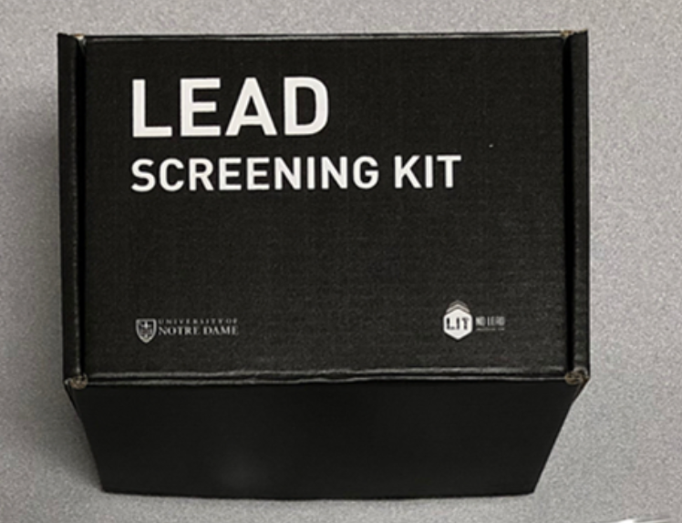
Limited Testing for Lead
Environmental inspections triggered by a lead-poisoned child⁷
Limited federal housing inspection requirements
Local inspection requirements
Home test kits
Indiana Collaboration for Lead Action and Prevention Lead Screening Kit, https://www.leadscreeningkit.com/about.

Slide 8
Limited Testing for Lead
Most Indiana children—even those most at risk—are not tested for lead.
  9 out of 10 children under seven⁸
  3 out of 4 children estimated to have BLLs of 10 µg/dL or more⁹
  3 out of 4 children two or younger on Medicaid¹⁰

Slide 9
Outdated Follow-up Services (until 2022)
2020 CDC
Recommendations¹¹
Pre-2022
Indiana Requirements¹²
CDC Reference Value:
BLL of 5 µg/dL
A child with 5 to 9.9 µg/dL
should receive:
Environmental assessment
Nutritional counseling
Follow-up testing
Elevated BLL:
Confirmed BLL of ≥ 10 µg/dL
A child with less than 10 µg/dL must receive:
Educational materials

Slide 10
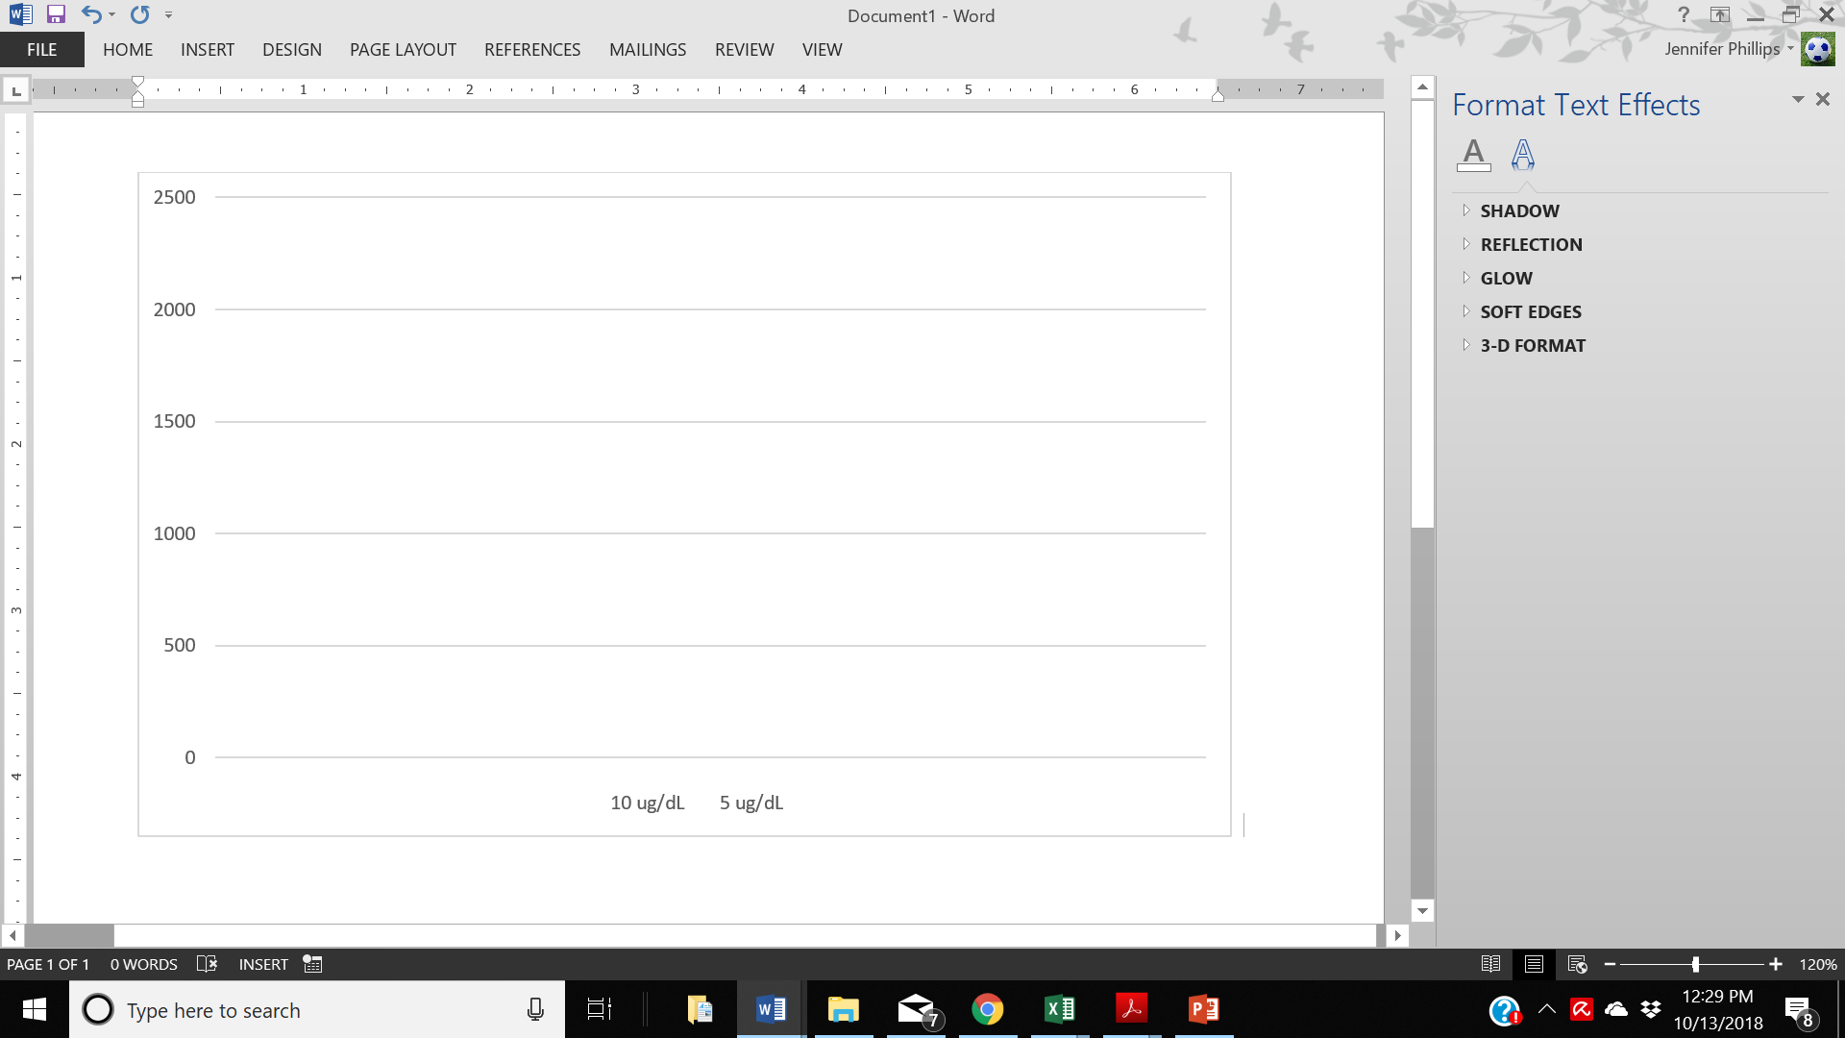
Indiana Children with BLLs ≥ 5 µg/dL (2016)
Until 2022, hundreds of Indiana children who needed important services were not guaranteed to receive them.¹³
1,847 children with BLLs of 5 to 9.9 µg/dL
Number Children Screened
Number Children Screened
177 children with BLLs of ≥ 10 µg/dL
≥ 10 µg/dL 5-9 µg/dL

Slide 11
Progress in Indiana
Ind. Code § 16-46-16.5
  House Enrolled Act 1007 (2021)
  Establishes a fund for the Indiana Department of Health to supply grants to reduce or prevent lead exposure, among other things
  Funded by federal American Rescue Plan dollars

Slide 12
Progress in Indiana
410 Ind. Admin. Code § 29
Updated in 2022 to lower Indiana’s “Elevated blood lead level” from 10 µg/dL to 3.5 µg/dL
Requires county health departments to provide educational materials and offer testing to other children in the home for children with BLL’s of 3.5 µg/dL or more
Requires assessment, environmental inspection, and other services for children with BLL’s of 5 µg/dL or more

Slide 13
Progress in Indiana
Ind. Code § 16-41-39.4-11
  House Enrolled Act 1313 (2022)
  Requires health care providers to determine if children under 6 have been screened for lead. If a child has not been screened, the health care provider must offer a test.
  Effective January 1, 2023
  Expires December 31, 2026

Slide 14
Policy Change in Indiana
2017-2018
April 2021
Sept. 2022
Research & outreach conducted; core support forms
Fall 2019
IDOH forms advisory council
HEA 1007 passed
410 IAC 29 adopted
2017
2023
Spring 2019
Nov. 2020
March 2022
Coalition expands; petition written
IN Advisory Committee to U.S. Commission on Civil Rights releases report
HEA 1313 passed
Jan. 2023
Universal screening begins
Summer 2019
Petition delivered to IDOH

Slide 15
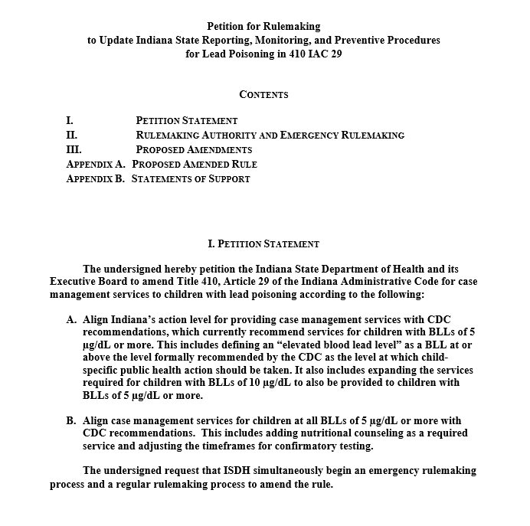
Policy Change in Indiana
Target the PROBLEM
Organize PEOPLE
Develop a PLAN

Slide 16

The Work Is Never Done
Akeeshea Daniels, former tenant of the West Calumet Complex and community advocate. Image Credit: Craig Lyons, East Chicago Lead Contamination Galvanizes Residents, https://www.chicagotribune.com/suburbs/post-tribune/ct-ptb-east-chicago-awakening-st-0101-20161230-story.html (Dec. 30, 2016).

Slide 17
References
1. Ind. Housing Dashboard, https://indianahousingdashboard.com/ (last visited Oct. 14, 2023).
2. Superfund Sites Where You Live, Environmental Protection Agency, https://www.epa.gov/superfund/search-superfund-sites-where-you-live
(last accessed Oct. 12, 2023).
3. Looking for Lead, https://www.reuters.com/investigates/graphics/lead-water/en/ (last accessed Oct. 12, 2023).
4. Environmental Injustice: Lead Poisoning in Indiana: A Report of the Indiana Advisory Committee to the U.S. Commission on Civil Rights 31 (Nov.
1, 2020), https://www.usccr.gov/files/2020/2020-11-12-Report-Lead-Poisoning-in-Indiana.pdf.
5. Elizabeth Chuck, Lead in Gasoline Blunted the IQ of Half the Population, Study Says, https://www.nbcnews.com/health/health-news/lead-
gasoline-blunted-iq-half-us-population-study-rcna19028.
6. Emily Benfer, Contaminated Childhood: How The United States Failed to Prevent the Chronic Lead Poisoning of Low-income Children and
Communities of Color, 41 Harvard Env. L. Rev. 493, 498 (2017).
7. Id. at 546.
8. Indiana State Department of Health, 2016 Childhood Lead Surveillance Report, https://www.in.gov/isdh/files/lead%20report%202016-
new.pdf.
9. Eric M. Roberts, et al., Assessing Child Lead Poisoning Case Ascertainment in the US, 1999-2010 Figure 2, 139 Pediatrics (2016).
10. Annual EPSDT Participation Report: FY 2017 Data, https://www.medicaid.gov/medicaid/benefits/epsdt/index.html (Indiana data).
11. Low-Level Lead Exposure Harms Children: A Renewed Call for Primary Prevention 37, Ctrs. for Disease Control & Prevention
https://www.cdc.gov/nceh/lead/docs/final_document_030712.pdf
12. 410 Ind. Admin. Code § 29 (readopted filed Nov. 2019).
13. Indiana State Department of Health, 2016 Childhood Lead Surveillance Report, https://www.in.gov/isdh/files/lead%20report%202016-
new.pdf.

