Slide 1
Abortion Rights as Disability Rights: Safeguarding Choice After Dobbs
Robyn M. Powell, PhD, JD
Hall Center for Law and Health Grand Rounds
November 9, 2023

Slide 2
Overview of Talk
Historical Context: Enduring Reproductive Control
The Importance of Abortion Rights for Disabled People
A Way Forward: Disability Reproductive Justice
Disability Reproductive Justice: Legal and Policy Considerations
Questions

Slide 3
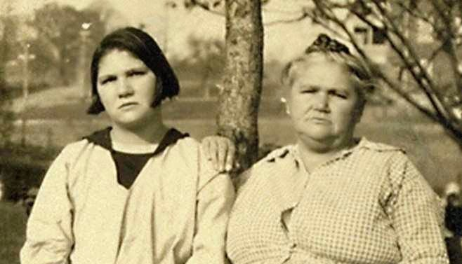
Historical Context: Enduring Reproductive Oppression
“The right to decide what happens to our bodies is a fundamental principle in the disability community, and with good reason.”
-- Rebecca Cokley

Slide 4


Slide 5
The Importance of Abortion Rights for Disabled People
Pervasive health inequities
Inadequate access to reproductive health services and information
Extreme economic disadvantages
High rates of violence
Challenges to bodily autonomy and self-determination

Slide 6
Pervasive Health Inequities
Health disparity population
Heightened maternal morbidity and mortality rates
Disability-related considerations
Medications that are contraindicated during pregnancy
Abortions to prevent health complications

Slide 7
Inadequate Access to Health Services and Information
High rates of unintended pregnancies
Pervasive attitudinal, communicative, physical, policy, programmatic, social, and transportation barriers
Contraceptive needs are routinely ignored
Decreased access to reproductive health information (e.g., sex education)

Slide 8
Extreme Economic Disadvantages
High rates of poverty
Significant disability-related expenses

Slide 9
High Rates of Violence
Sexual assault
Intimate partner violence
Reproductive coercion

Slide 10
Challenges to Bodily Autonomy and Self-Determination
The legacy of eugenics
Ongoing restrictions on reproductive freedom

Slide 12

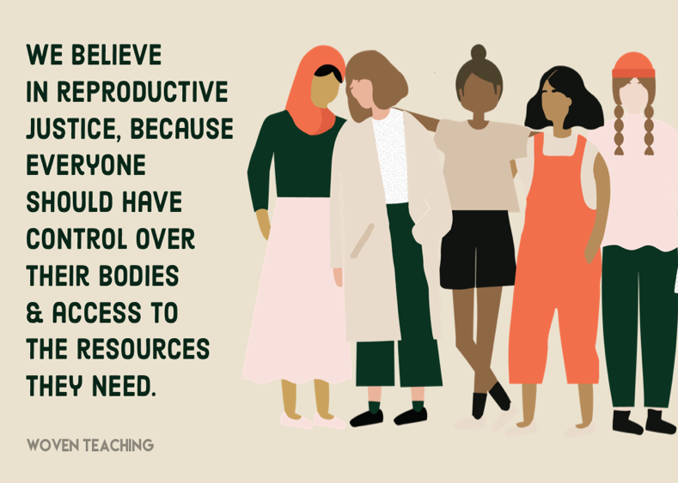
A Way Forward: Disability Reproductive Justice

Slide 13
Disability Reproductive Justice: Legal and Policy Considerations
Confront intersecting oppressions
Center people with disabilities as leaders in the fight for abortion rights
Defend bodily autonomy and self-determination
Protect and expand abortion rights and access
Ensure accessible reproductive health services and information
Guarantee rights, justice, and wellness

Slide 14
Confront Intersecting Oppressions
Interrogating and challenging the structural, legal, and institutional factors that cause oppression
Cross-movement solidarity

Slide 15
Center People with Disabilities as Leaders in the Fight for Abortion Rights
Confronting tensions between movements
Purposefully engaging disabled people, especially disabled people of color and LGBTQ+ disabled people
Putting disabled people in leadership roles

Slide 16
Defend Bodily Autonomy and Self-Determination
Challenge guardianship
Promote supported decision-making and other less restrictive alternatives
Repeal forced sterilization and abortion laws

Slide 17
Protect and Expand Abortion Rights and Access
Repeal the Hyde Amendment and fund abortion care
Increase access to medication abortion and telehealth
Ensure access to abortion facilities
Codify abortion rights into federal law
State-level advocacy

Slide 18
Ensure Accessible Reproductive Health Services and Information
Increased compliance with and enforcement of the ADA, Section 504, and Section 1557
Enact regulations concerning diagnostic medical equipment
Pass the Reproductive Health Care Accessibility Act
Address transportation barriers
Provide comprehensive and accessible information about sexuality and reproduction

Slide 19
Guarantee Rights, Justice, and Wellness
Confront economic disadvantages
Address discrimination by the child welfare system

Slide 21
Disability Reproductive Justice, 170 University of Pennsylvania Law Review 1851 (2022)
Including Disabled People in the Battle to Protect Abortion Rights: A Call-to-Action, 70 UCLA Law Review 774 (2023)
Forced to Bear, Denied to Rear: The Cruelty of Dobbs for Disabled People, 112 Georgetown Law Journal __ (forthcoming 2024)

Slide 22

Thank You! rpowell@ou.edu

