Slide 1

Transgender Health Care and the Law: Where We Stand
Professor Nan D. Hunter
With assistance from Cameron Mulrooney, Class of 2024
Georgetown Law
© 2024 Nan D. Hunter

Slide 2
Organization of Webinar
Overview of anti-trans state laws
Overview of legal issues
II. Types of laws most directly related to health and medicine and the legal issues they raise:
Restrictions on restroom use in schools
Participation in sports
Bans on gender-affirming care
III. What to expect next from the courts
IV. Questions and answers
[Interspersed with 3 poll questions]

Slide 3


I. Phenomenon of Anti-Trans Legislation 2019-23
992+ Anti-trans bills introduced
134+ Anti-trans laws enacted

Slide 4
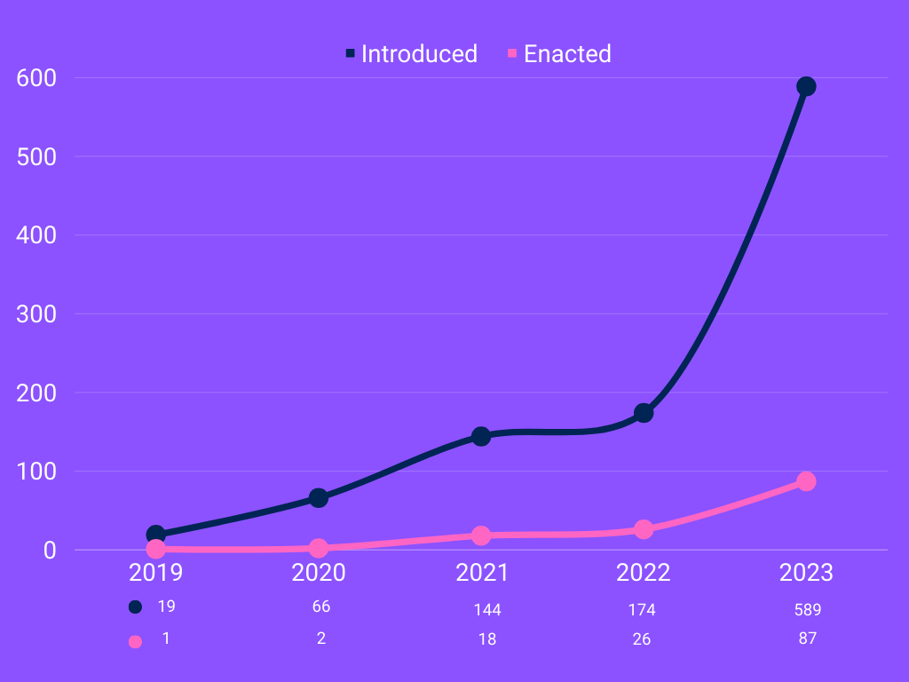
Anti-Trans Legislation 2019-23

Slide 5
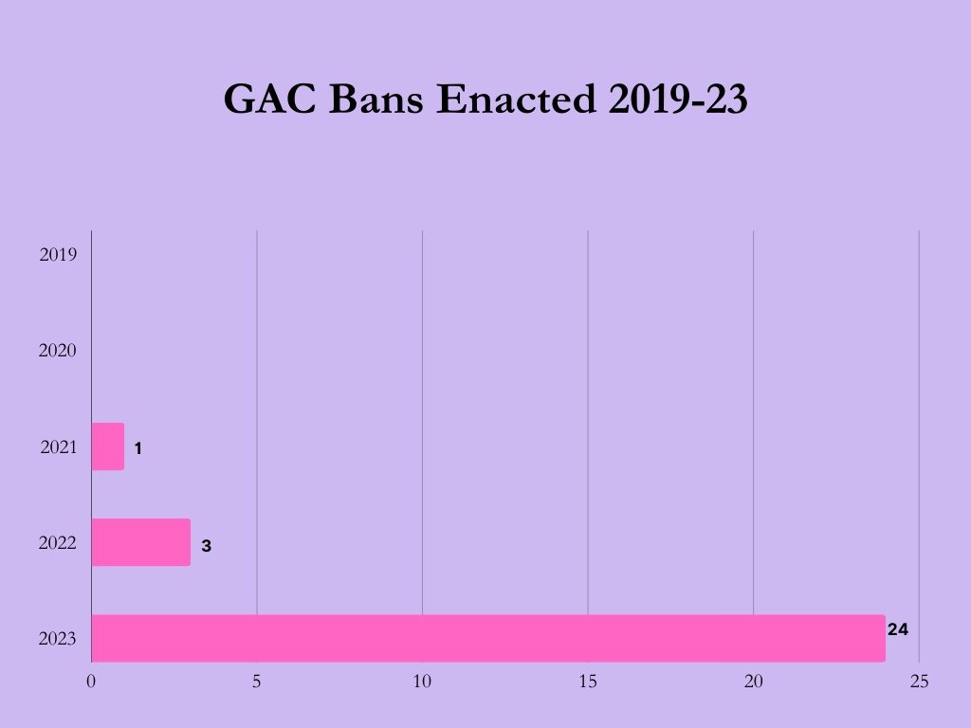
Gender-Affirming Care Bans Enacted

Slide 6
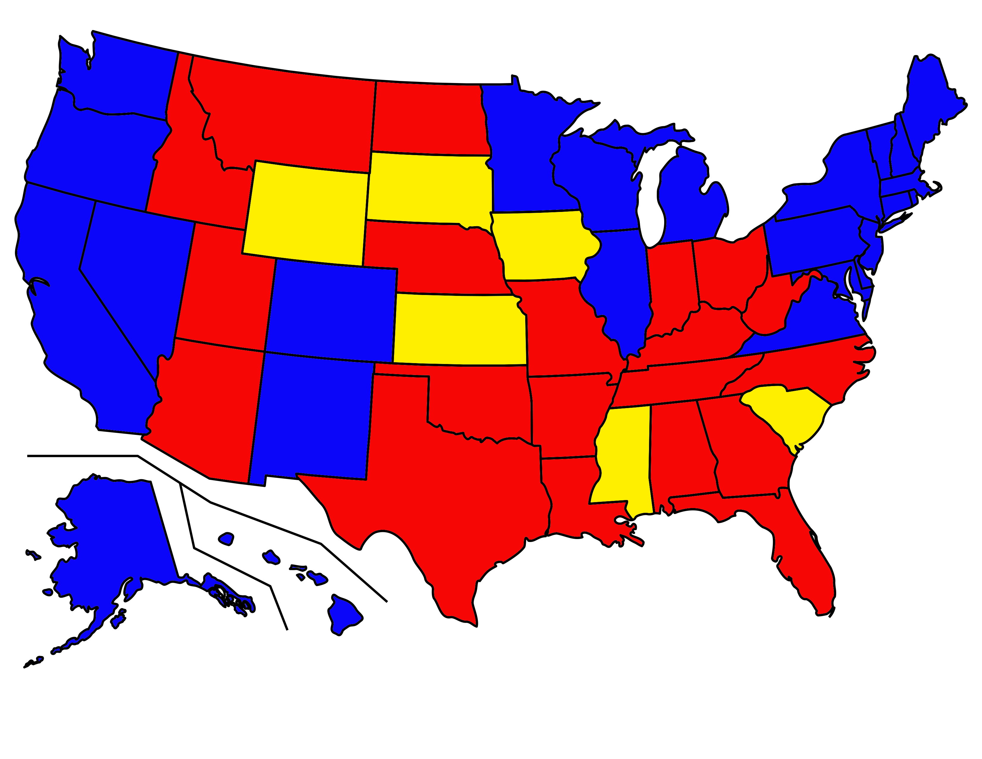
Anti-Trans Laws
All enacted by states; no federal laws.
In any of the 3 medical categories
New POLL Slide
New POLL Slide
No anti-trans laws enacted
Anti-trans law(s) enacted and unchallenged
Anti-trans law(s) enacted and challenged

Slide 7
types of laws Most Settled: Bathroom Use Sports Participation By Transgender Students Bans On Gender-Affirming Care SUBSTANTIVE LEGAL ISSUES Sex Discrimination: Statutory and Constitutional Claims Parent’s Due Process Right to Determine Medical Treatment for Child CRITERIA FOR PRELIMINARY INJUNCTION
II. Overview of Legal Issues

Slide 8

II. (A) Restroom Restrictions

Slide 9
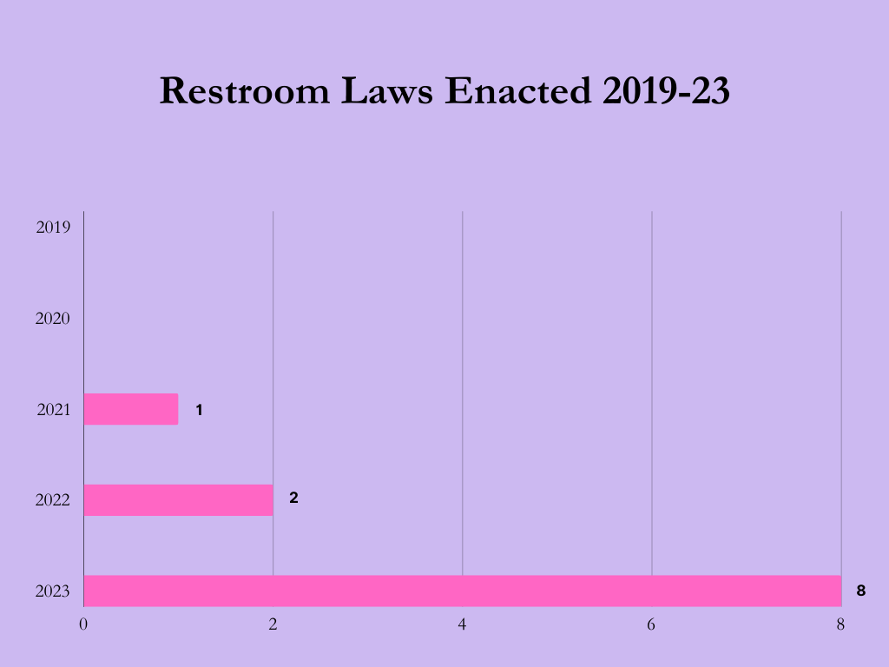

Slide 10
Restroom Use – Utah Law
Sex-designated privacy spaces in public schools.
To preserve the individual privacy of male and female students in the public education system, a student may only access an operational sex-designated privacy space within a public school that is designated for student use if the student's sex corresponds with the sex designation of the privacy space. . . .
(4) [Acceptable evidence of an individual’s sex:]
(a) the student's unamended birth certificate that corresponds with the sex designation of privacy space, which may be supported with a review of any amendment history obtained under Section 26B-8-125; or
(b) documentation of a medical treatment or procedure that is consistent only with the sex designation of the privacy space.
(5) Subsection (1) does not apply to:
(a) a unisex or single-occupant facility; or
(b) an intersex individual.
— 63G-31-301

Slide 11
Legal Issues – Title IX Prohibition on Sex Discrimination
Bostock v. Clayton County, 140 S.Ct. 1731 (2020), held that the prohibition of “discrimination based on sex” in Title VII (workplaces) of the 1964 Civil Rights Act included discrimination based on gender identity and sexual orientation
“Takes sex into account” → “But for” analysis of text
Decision did not address issues related to bathroom use
But DID settle the question of coverage, i.e., that discrimination based on SO/GI is covered by the prohibition of sex discrimination under existing federal law
Nationwide application – all workplaces with 15 or more employees
In fact, there are now essentially no workplace cases involving bathroom issues except for religious organization employers

Slide 12
Why a Relatively Settled Issue
1. Most courts have held that Bostock controls interpretation of Title IX:
Title IX (schools) also prohibits “discrimination based on sex”
Same statutory language → same but-for test
2. Does a bathroom restriction violate the Constitution?
Courts generally interpret whether a law that differentiates based on sex violates the Constitution (the Equal Protection Clause of the Fourteenth Amendment) so that it produces the same outcome as the test used for statutory provisions (Title VII or Title IX). Example: the public sector employee.
Most courts have held that a restriction on bathroom use based on gender identity is a form of sex discrimination under the Constitution as well as under Title IX.

Slide 13
AND – A Critical Underlying Issue : Should a Preliminary Injunction Be Granted?
Preliminary injunction can be granted relatively quickly after a case is filed, often on the basis of affidavits.
Criteria
Likelihood of success on the merits
Likelihood of irreparable harm
Balance of the equities
Public interest
Preliminary injunction will remain in effect until the trial court completes the adjudication of the case on its merits

Slide 14
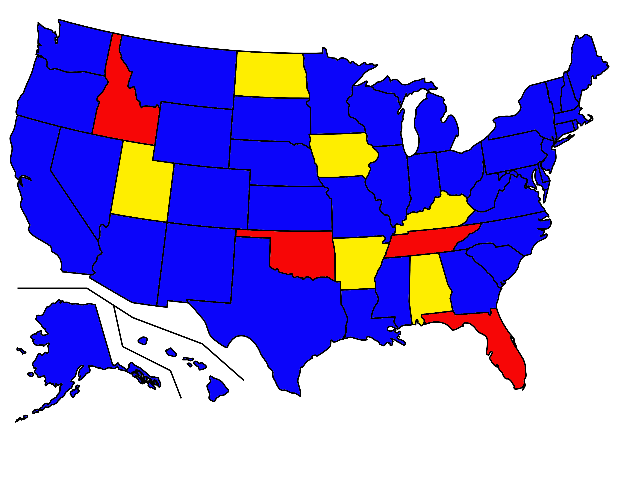
Restroom Laws
No statewide restroom laws enacted
Restroom law(s) enacted and unchallenged
Restroom law(s) enacted and challenged

Slide 15
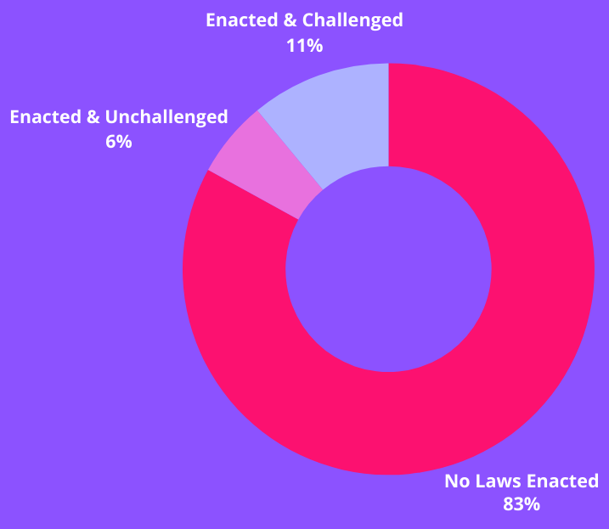
Restroom Laws:
% of US Population Living in a State Where…

Slide 16

Transgender student sued Indiana school district.
Federal District Court granted preliminary injunction for Plaintiff.
7th Circuit Court of Appeals affirmed. 75 F.4th 760
School district sought review in Supreme Court.
Cert denied 1/16/2024 on question of whether there should be only one nation-wide policy
Focus Case: AC v. Metropolitan School District

Slide 17
II. (B) Sports Restrictions

Slide 18
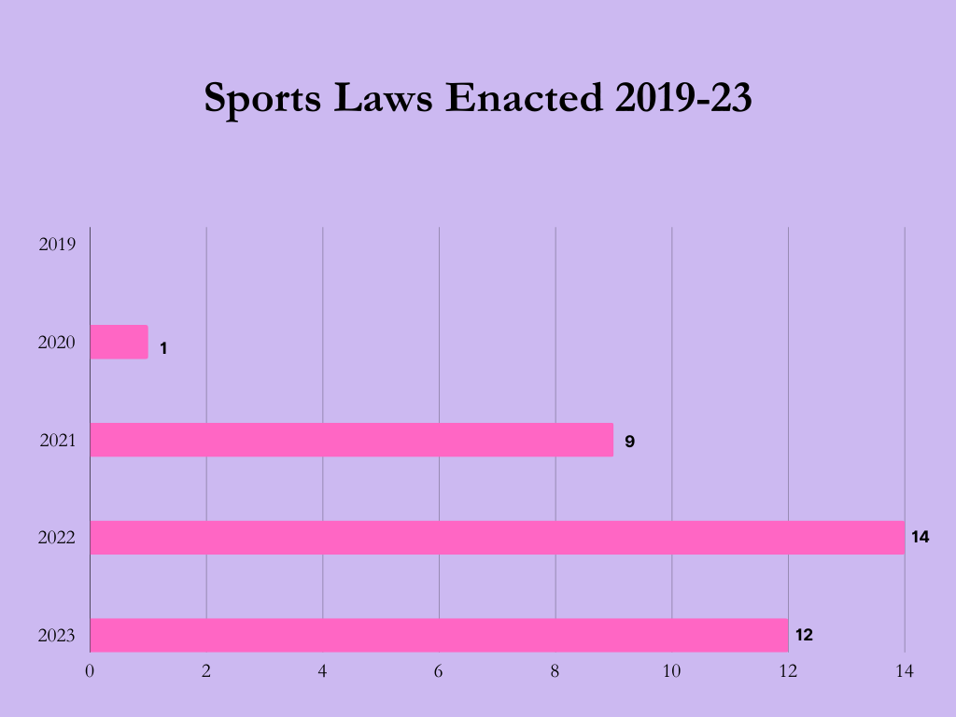

Slide 19
Sports – Idaho Law
(1) Interscholastic, intercollegiate, intramural, or club athletic teams or sports that are sponsored by a public school or any school that is a member of the Idaho high school activities association or a public institution of higher education or any higher education institution that is a member of the national collegiate athletic association (NCAA) . . . shall be expressly designated as one (1) of the following based on biological sex:
(a) Males, men, or boys;
(b) Females, women, or girls; or
(c) Coed or mixed.
( (3) If disputed, a student may establish sex by presenting a signed physician's statement that shall indicate the student's sex based solely on:
(a) The student's internal and external reproductive anatomy;
(b) The student's normal endogenously produced levels of testosterone; and
(c) An analysis of the student's genetic makeup.
— ID HB 500

Slide 20
The Role of Interscholastic Assns
National Governing Bodies (NGBs): Many sports have NGBs with their own trans participation policies. These vary across organizations but may consider factors like hormone therapy and time since transition.
State Athletic Associations (SAAs): Some SAAs, independent of legislation, have adopted policies related to transgender athletes. These vary by state and can specify eligibility criteria or require consultation with NGBs. (Connecticut policy allowing trans athletes upheld by federal district court.)
Mediating regulatory institutions - Laws generally do not prohibit local school districts from setting their own athletic participation policies but there may be a risk of disqualification.

Slide 21
Comparison to Bans:.
State laws that ban transgender students from school sports generally take a blanket approach, excluding trans athletes based solely on their assigned sex at birth.
By contrast, existing interscholastic association policies often involve varying degrees of individual assessment and consideration of factors like fairness, safety, and inclusivity

Slide 22
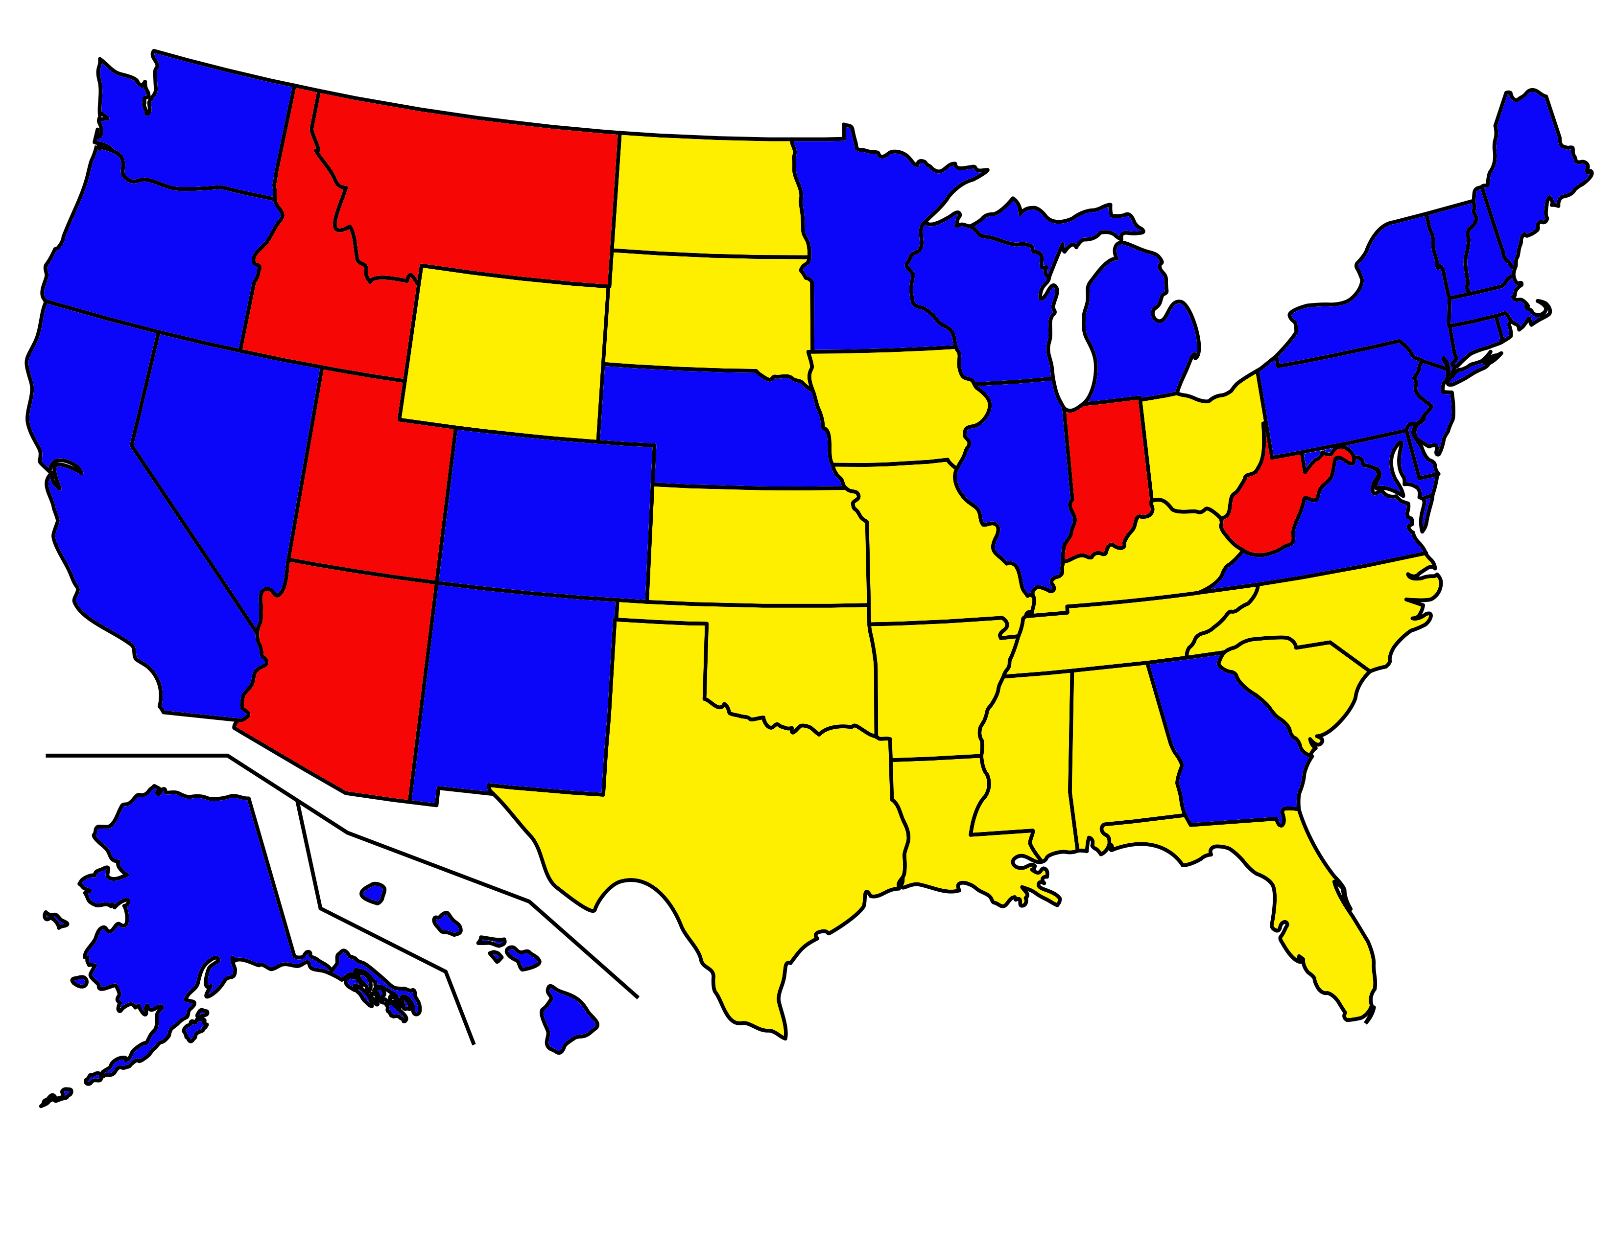
Sports Laws
No sports laws enacted
Sports law(s) enacted and unchallenged
Sports law(s) enacted and challenged

Slide 23
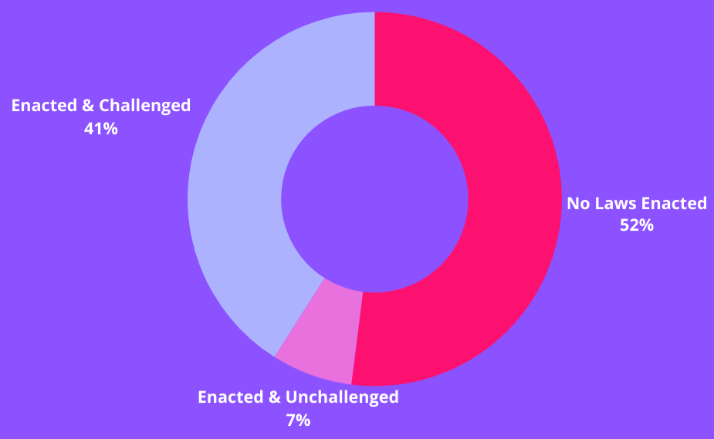
Sports Laws:
% of US Population Living in a State Where…

Slide 24
Trial court denied preliminary injunction to Plaintiff *
Appeals court for 4th Circuit reversed, granted injunction.
US Supreme Court declined review; dissent by Alito, Thomas.
10/26/2023 – Oral argument in 4th Circuit
Next stop: Back up to the Supreme Court
Focus Case: B.P.J. v. West Virginia

Slide 25
Legal Issues in BPJ
What constitutes discrimination based on sex
Does a ban on transgender athletes (trans girls) violate Title IX?
Does a ban on transgender athletes (trans girls) violate the Constitution (Equal Protection Clause)?

Slide 26
II. (C) Gender-Affirming Care Bans

Slide 27
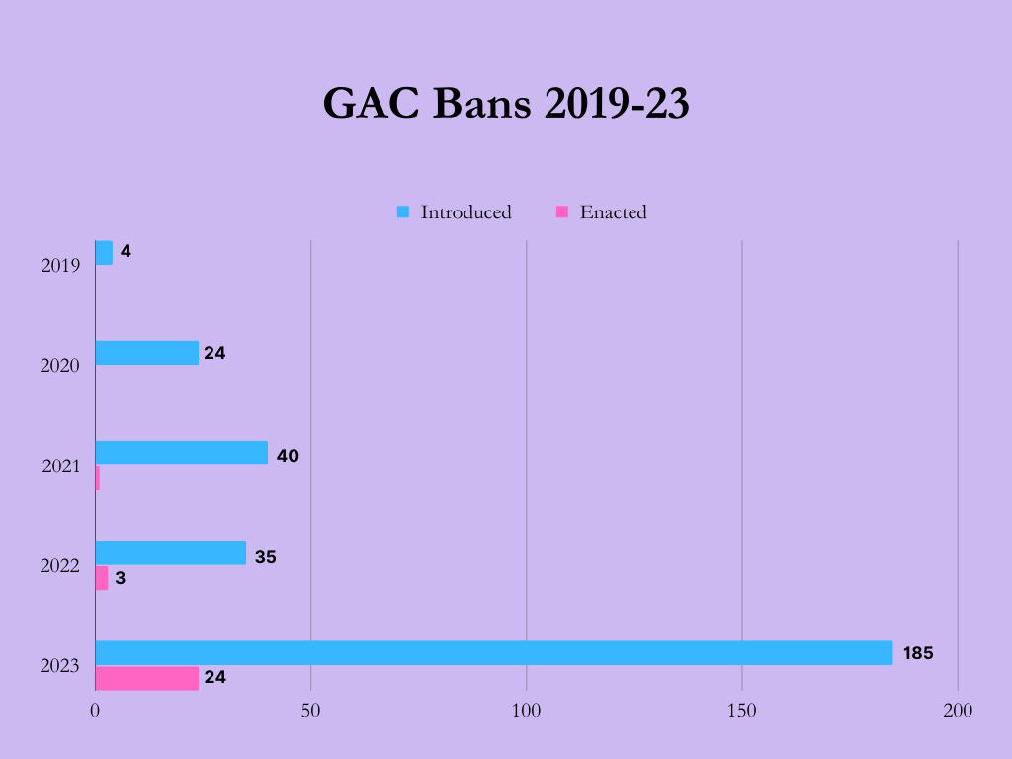
1

Slide 28

Gender-Affirming Care
 | What is it? | When is it used? | Reversibility
Social Affirmation | Adopting gender-affirming hairstyles, clothing, name, gender pronouns, and restrooms and other facilities | Any age or stage | Reversible
Puberty Blockers | Using certain types of hormones to pause pubertal development | During puberty | Largely Reversible
Hormone Therapy | Testosterone or estrogen hormone replacement therapy | Early adolescence onward | Partially Reversible
Gender-Affirming Surgeries | “Top” surgery – to create a feminine or masculine chest “Bottom” surgery – surgery on genitals or reproductive organs Facial feminization/masculinization & other procedures | Adulthood or on case-by-case basis in late adolescence | Non-reversible

Slide 29
Tennessee Ban
(a)(1) A healthcare provider shall not knowingly perform or offer to perform on a minor, or administer or offer to administer to a minor, a medical procedure if the performance or administration of the procedure is for the purpose of:
(A) Enabling a minor to identify with, or live as, a purported identity inconsistent with the minor's sex; or
(B) Treating purported discomfort or distress from a discordance between the minor's sex and asserted identity.
— TN SB 1 (Enacted)

Slide 30
Tennessee Exceptions
(b )( 1) It is not a violation of subsection ( a) if a healthcare provider knowingly performs, or offers to perform, a medical procedure on or administers, or offers to administer, a medical procedure to a minor if: ·
(A) The performance or administration of the medical procedure is to treat a minor’s congenital defect, precocious puberty, disease, or physical injury . . .
— TN SB 1 (Enacted)

Slide 31
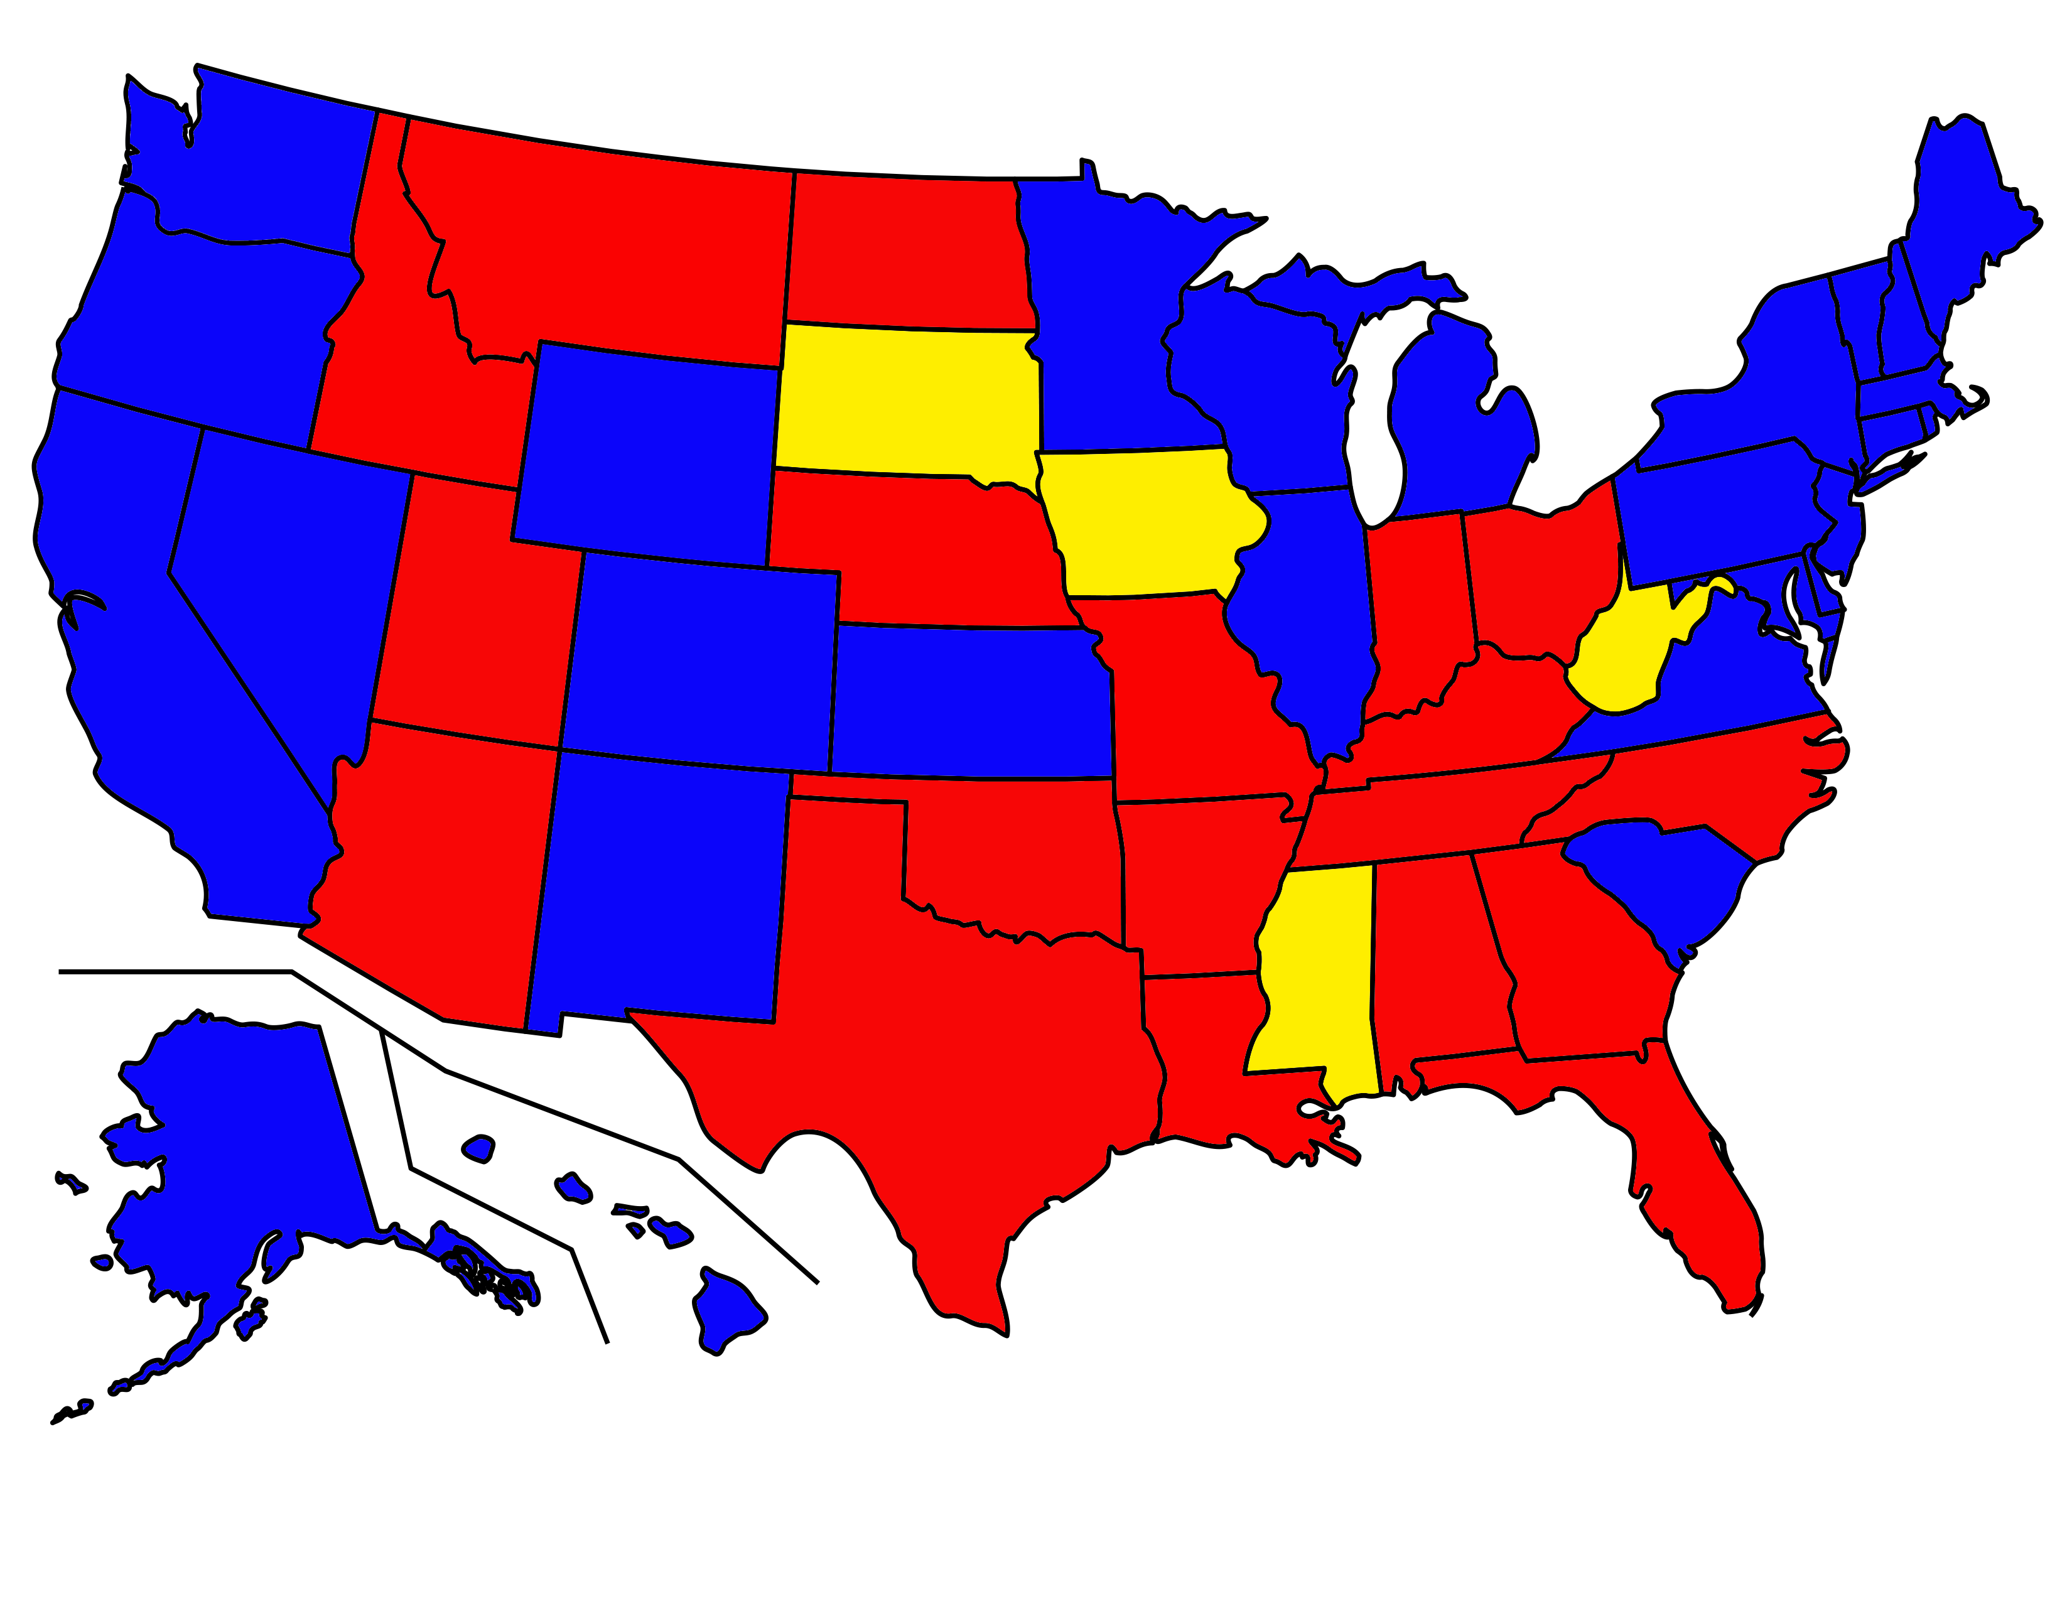
GAC Laws
No anti-GAC laws enacted
Anti-GAC law(s) enacted and unchallenged
Anti-GAC law(s) enacted and challenged

Slide 32
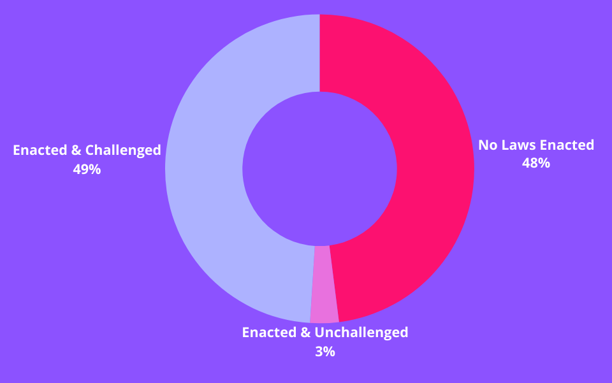
GAC Laws:
% of US Population Living in a State Where…

Slide 33
Federal District Courts enjoined Tennessee and Kentucky bans on GAC.
Sixth Circuit reversed with one dissent – first appellate court to allow a blanket prohibition to take effect. 83 F4th 460.
Cert petitions filed by Plaintiff and Solicitor General.
Listed for March 15 conference
Focus Case: LS v Skrmetti

Slide 34
Arkansas ban on gender-affirming care.
Federal District Court granted preliminary injunction; 8th Circuit affirmed.
On remand, TRIAL. >300 findings of fact. Permanent injunction granted. 2023 WL 4073727.
On appeal, initial en banc hearing granted.
Oral argument not yet set.
Focus Case:
Brandt v. Griffin

Slide 35
Legal Issues in Gender-Affirming Care Cases
Does a ban on use of some medications for girls and not boys and vice versa violate the Constitution (Equal Protection Clause)?
Does blanket ban on use of medications sought by parents for treatment of their children violate the rights of parents under the Due Process Clause?

Slide 36
What To Expect Next
Supreme Court – 2024-2025 Term
Gender-affirming care _ Skrmetti, Brandt
Sports - BPJ
State Legislatures and Congress
Already >400 bills introduced since January 1
Congress – most likely in the summer in the House
State-wide Elections
Will these issues become salient in elections for governor, state attorney general, U.S. Senate?
Presidential Election
Anything could happen

Slide 37

Thank you!
ndh5@law.georgetown.edu

