Slide 1
Bruen’s Burdens in the Ongoing Fight Against Gun Violence
Michael R. Ulrich, JD, MPH
Assistant Professor
Center for Health Law, Ethics, & Human Rights
Boston University School of Public Health
Boston University School of Law
BU Center for Antiracist Research
BU Center for Emerging Infectious Diseases

Slide 2
Roadmap
Bruen
Public health impact
  Guns in public
  Gun violence disparities
Privatizing policing
Bruen’s methodology & Second Amendment right
United States v. Rahimi
  Restrictions under domestic violence restraining orders

Slide 3
District of Columbia v. Heller (2008)
Right of self-defense
  Central to the 2nd Amendment right
  Individual right
  “Whatever it leaves for future evaluation, it surely elevates above all other interests the right of law-abiding, responsible citizens to use arms in defense of hearth and home.”
Right isn’t for everyone
  Long-standing prohibitions for felons, mentally ill, and sensitive places presumptively legal
Right belongs to “law-abiding citizens”
Analytical focus: language, structure, history

Slide 4
NYSRPA v. Bruen (2022)
Issue: “proper cause” restriction for carrying firearms in public
Constitutional test:
  (1) “when the Second Amendment’s plain text covers an individual’s conduct, the Constitution presumptively protects that conduct.”
  (2) “government must demonstrate that the regulation is consistent with this Nation’s historical tradition of firearm regulation.”
Part (2): How & Why
  “whether modern and historical regulations impose a comparable burden on the right of armed self-defense and whether that burden is comparably justified”

Slide 5


Slide 7
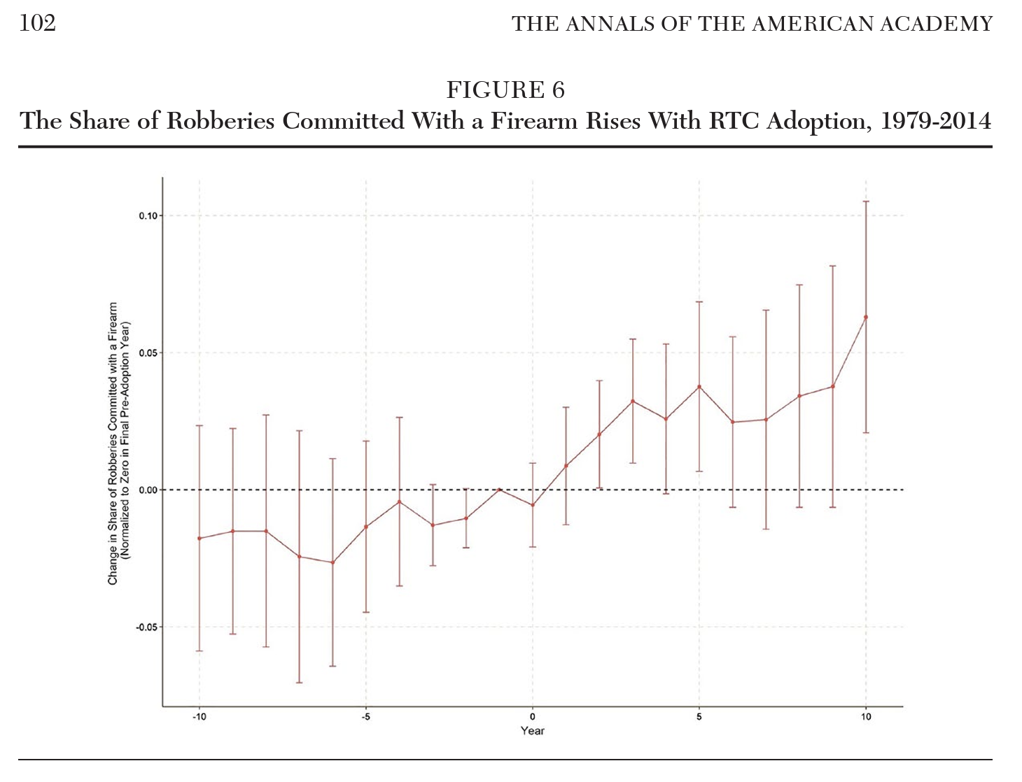
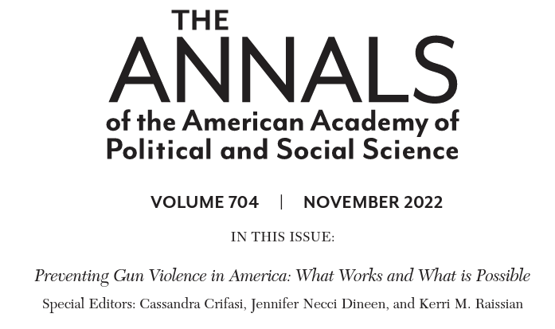

Slide 8
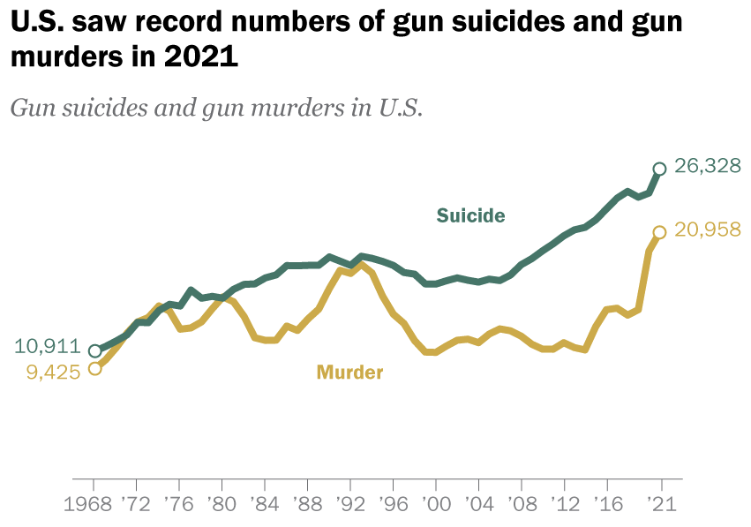
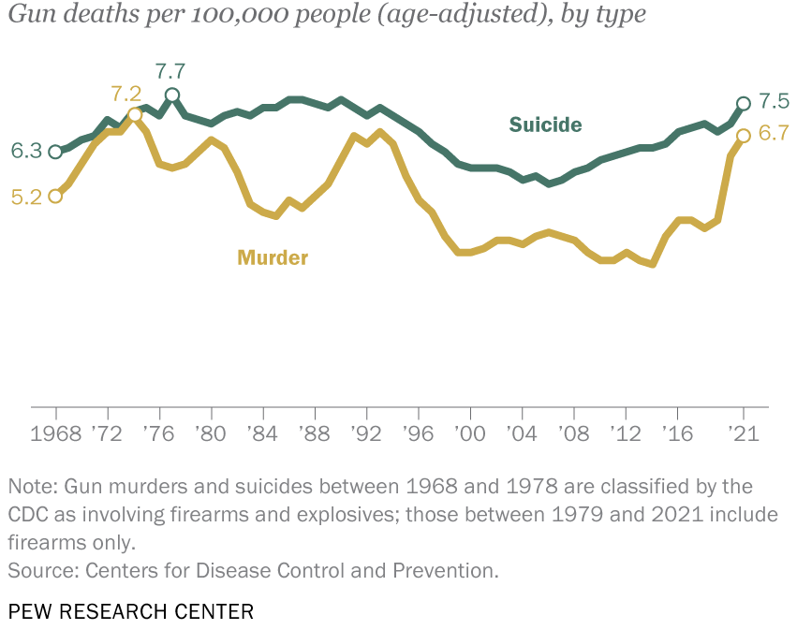

Slide 9
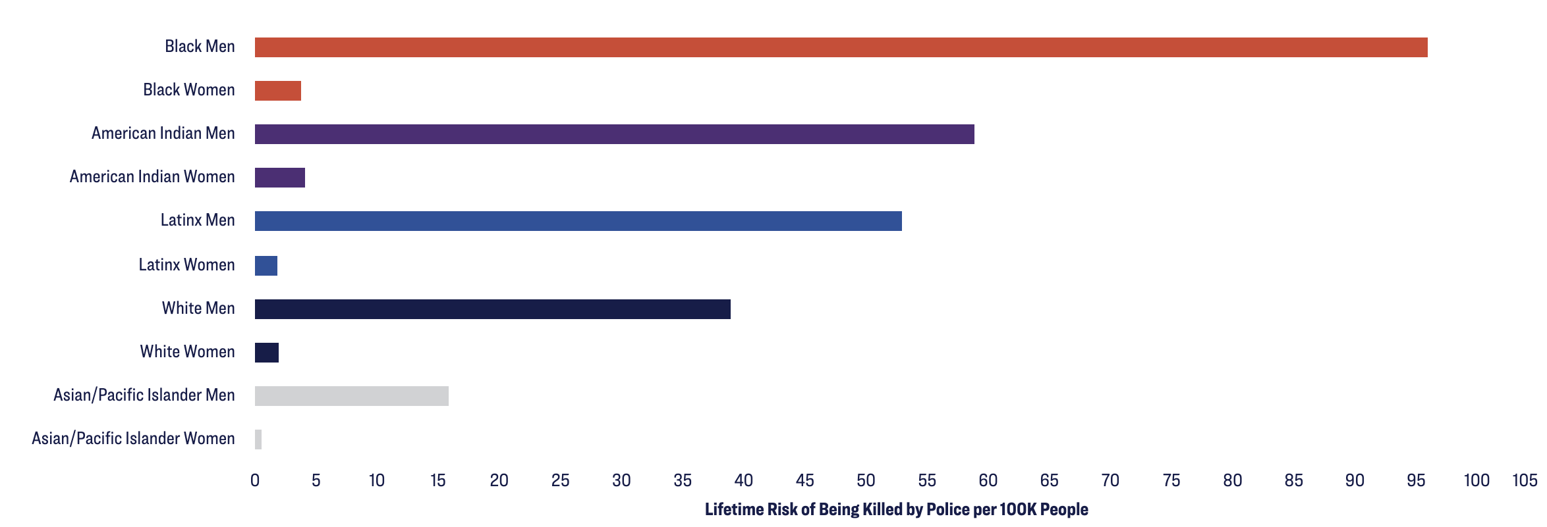
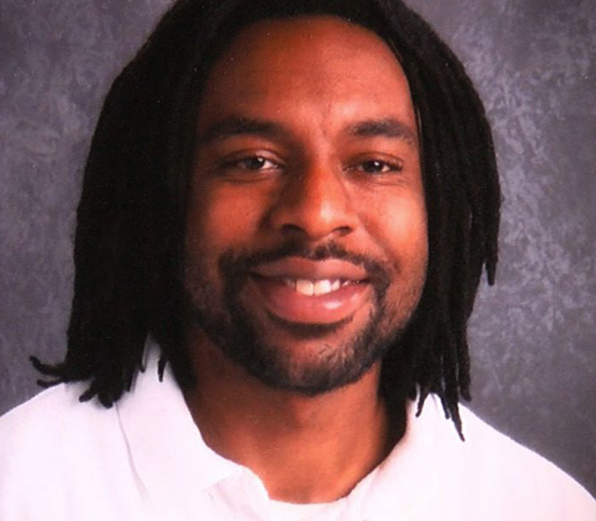
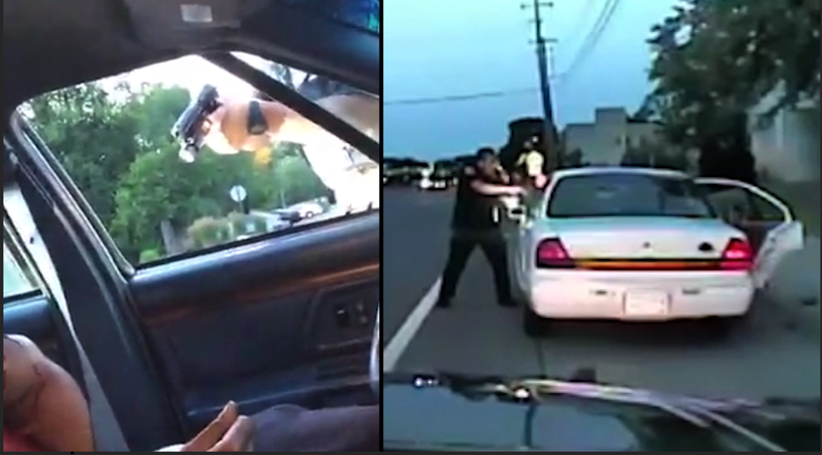

Slide 10
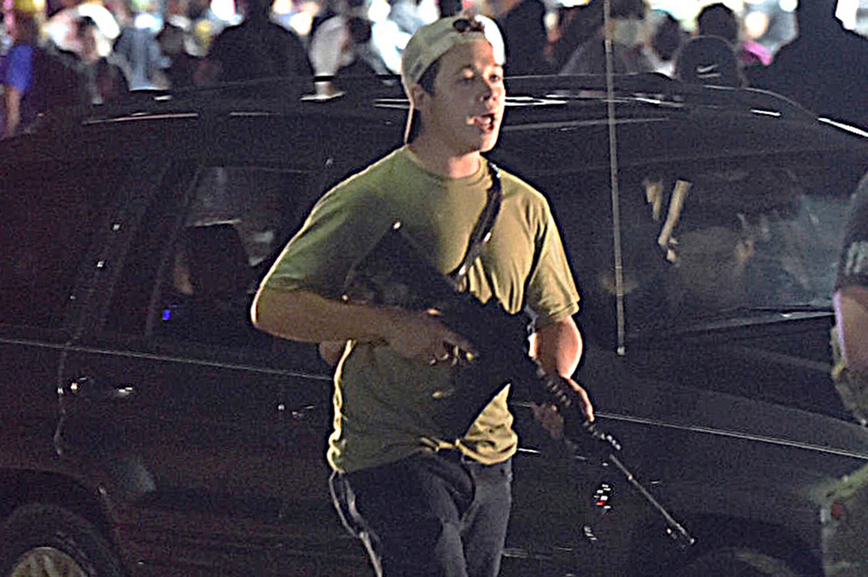

Slide 12
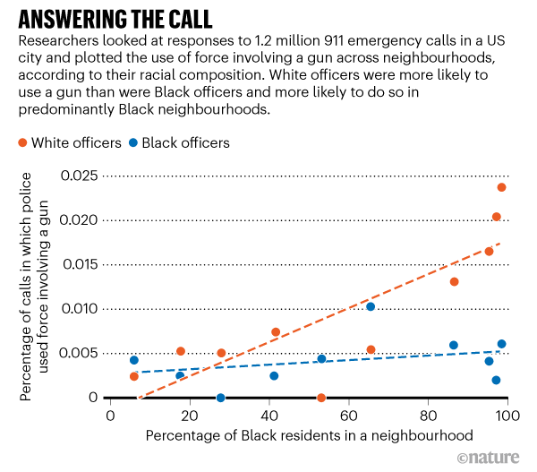

Slide 13
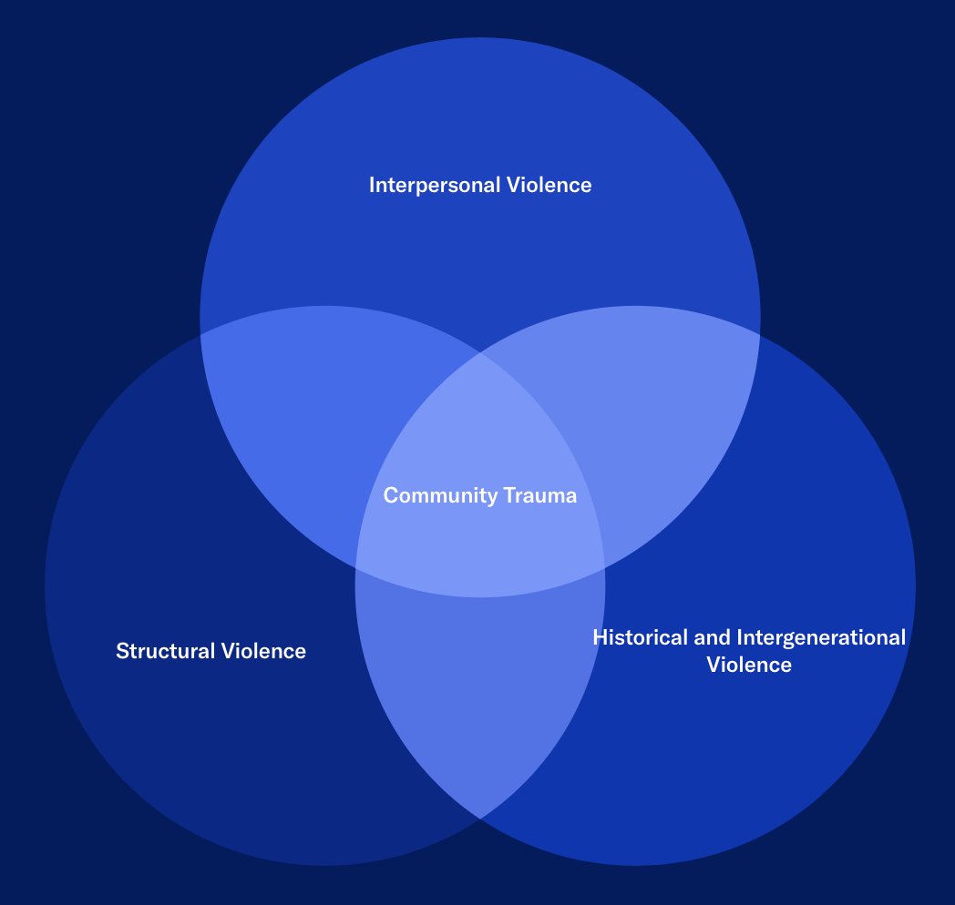

Slide 14
NYSRPA v. Bruen (2022)
(Alito, J., concurring)
“The police cannot disarm every person who acquires a gun for use in criminal activity; nor can they provide bodyguard protection for the State’s nearly 20 million residents or the 8.8 million who live in New York City.”
“In 1791, when the Second Amendment was adopted, there were no police departments, and many families lived alone on isolated farms or on the frontiers. If these people were attacked they were on their own.”

Slide 15
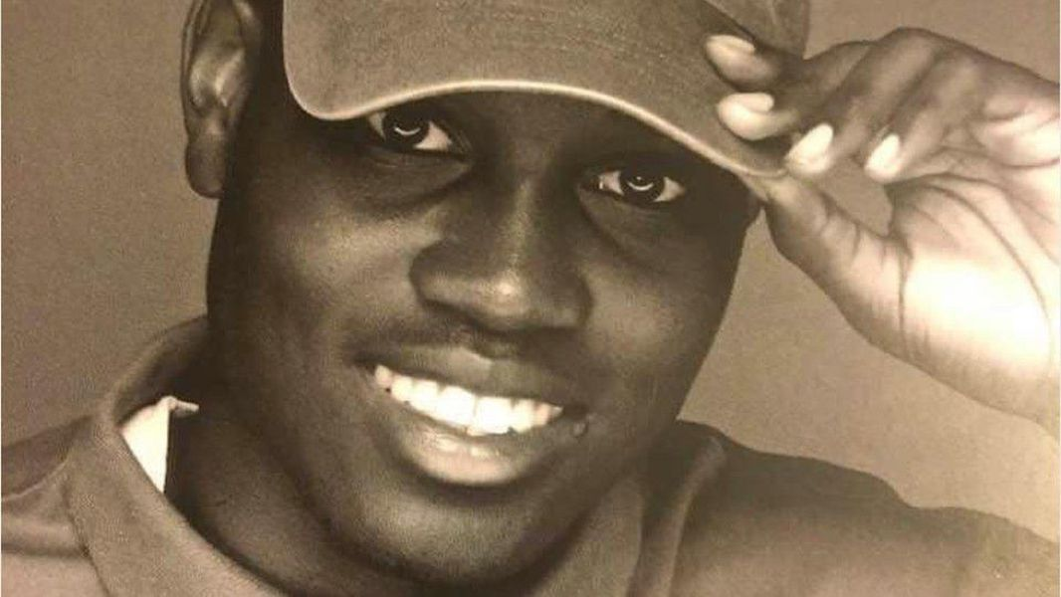
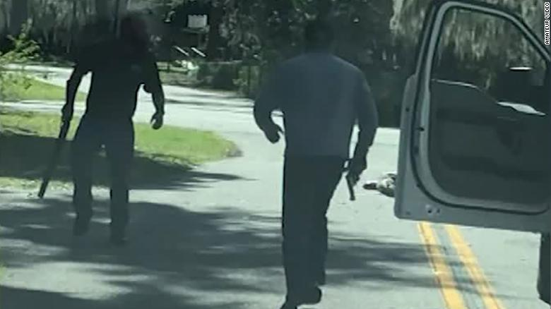

Slide 16
Stand Your Ground Laws

Slide 17
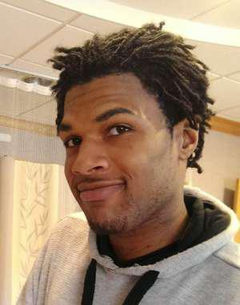


Slide 18
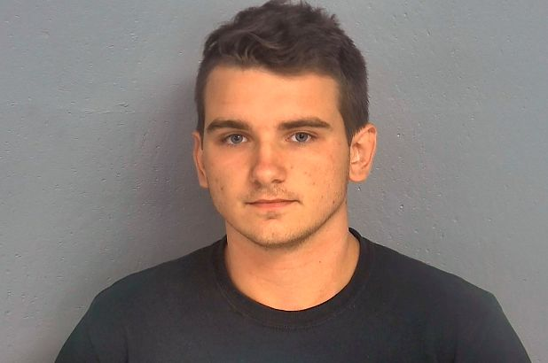
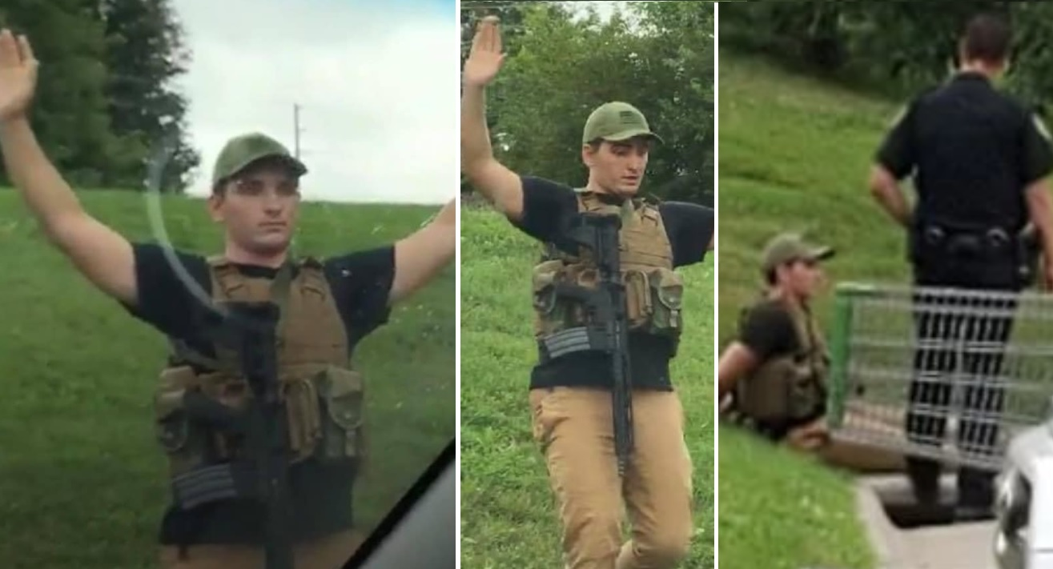

Slide 20
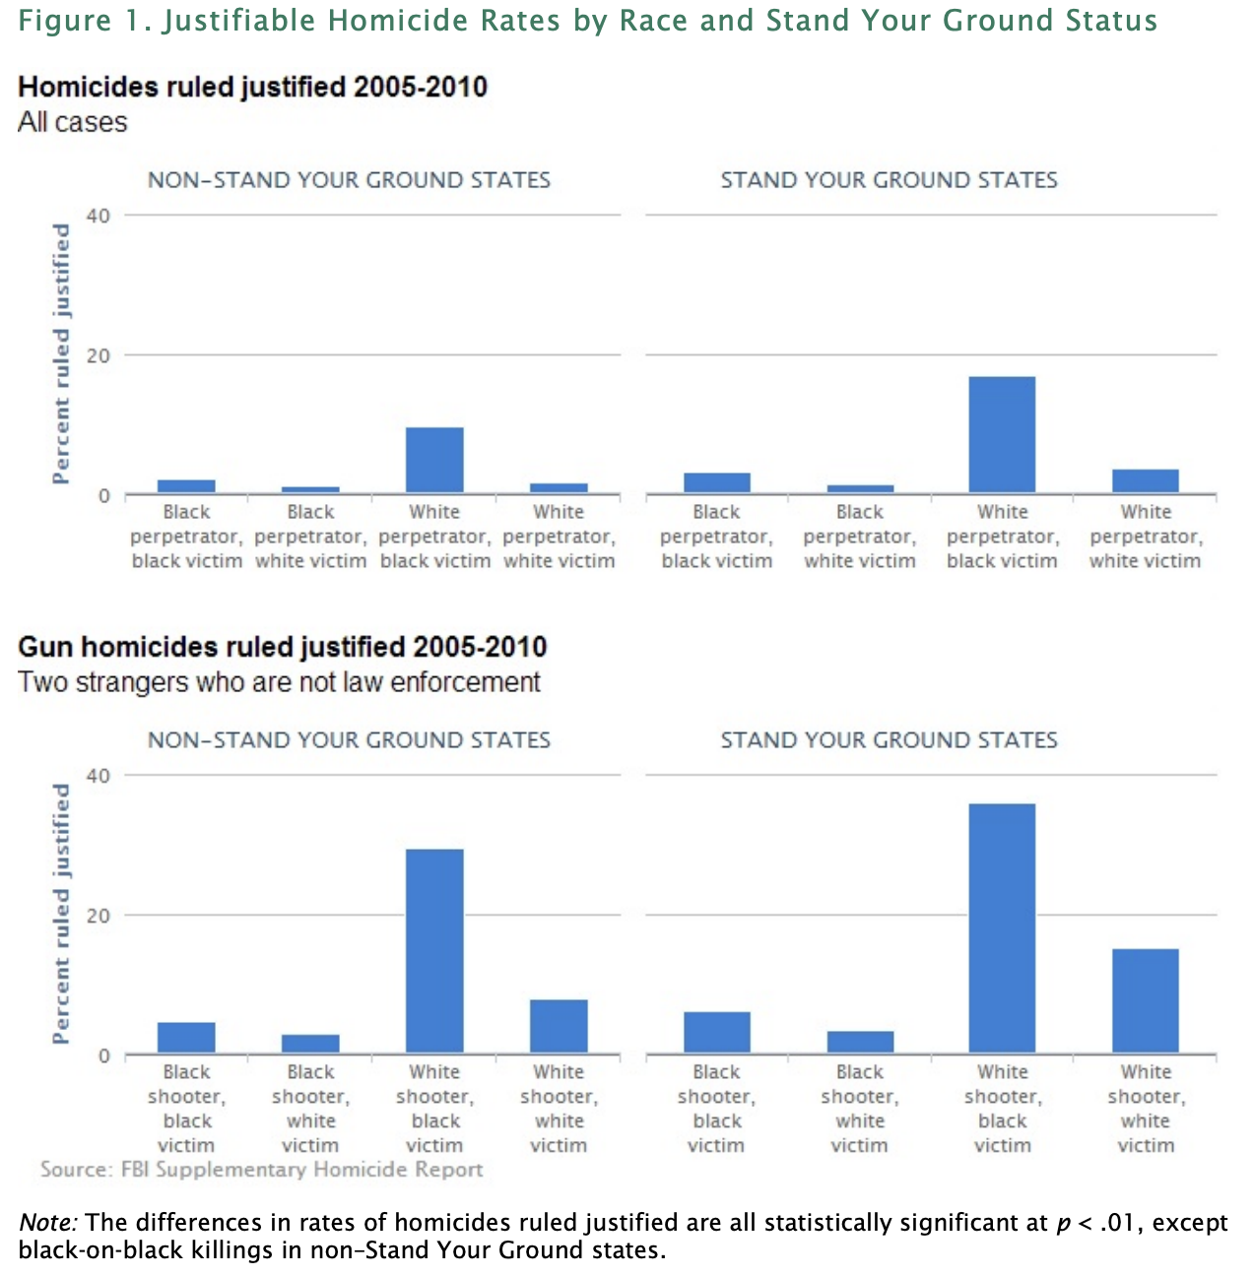

Slide 21
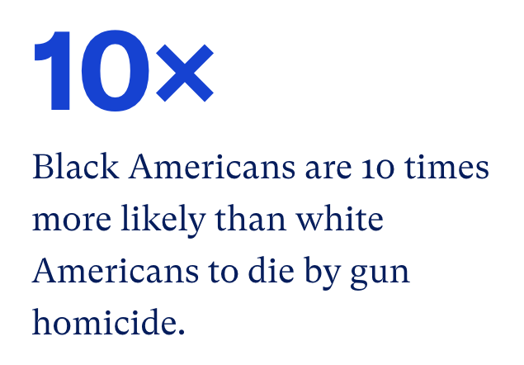

Slide 22
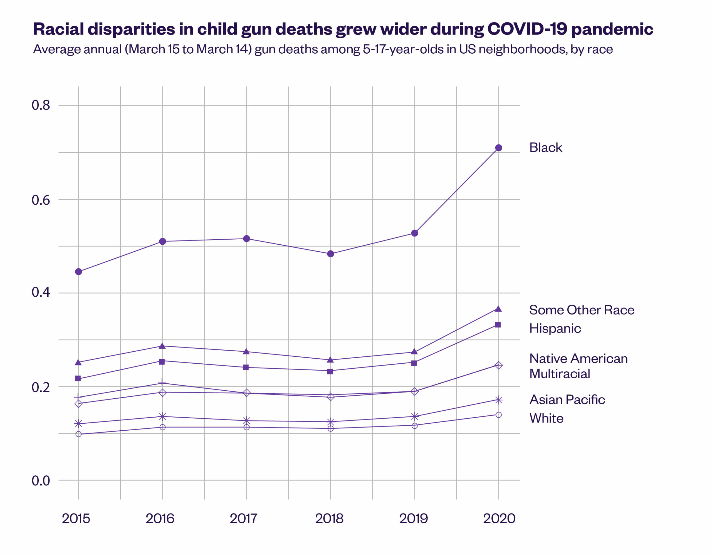

Slide 23
NYSRPA v. Bruen (2022)
Cites Dred Scott: “even Chief Justice Taney recognized (albeit unenthusiastically in the case of blacks) that public carry was a component of the right to keep and bear arms—a right free blacks were often denied in antebellum America.”
“the Freedman’s Bureau regularly kept [Congress] abreast of the danger to blacks and Union men in the postbellum South. The reports described how blacks used public carried weapons to defend themselves and their communities.”

Slide 24
NYSRPA v. Bruen (2022)
“when a challenged regulation addresses a general societal problem that has persisted since the 18th century, the lack of a distinctly similar historical regulation addressing that problem is relevant evidence that the challenged regulation is inconsistent with the Second Amendment.”

Slide 25
United States v. Rahimi (oral argument 11/7/23)
Issue: prohibiting firearms possession by people subject to domestic violence restraining orders
Analytical test:
  (1) “when the Second Amendment’s plain text covers an individual’s conduct, the Constitution presumptively protects that conduct.”
  (2) “government must demonstrate that the regulation is consistent with this Nation’s historical tradition of firearm regulation.”
Part (2): How & Why
  “whether modern and historical regulations impose a comparable burden on the right of armed self-defense and whether that burden is comparably justified”

Slide 27
United States v. Perez-Gallan (U.S. District Court for the Western District of Texas)
“No longer can lower courts account for public policy interests, historical analysis being the only tool.”
“Domestic violence, or violence against anyone for that matter, is not just a modern problem.”

Slide 28
United States v. Perez-Gallan (U.S. District Court for the Western District of Texas)
“it is better to draw the curtain, shut out the public gaze, and leave the parties to forget and forgive” (quoting the North Carolina Supreme court in 1874)
“even into the early twentieth century, judges were ‘more likely to confiscate a wife beater’s liquor than his guns.’”
“whether the colonies considered domestic abusers a ‘threat to public safety.’ The Government and the Court’s historical inquiries above don’t support that conclusion.”

Slide 29
United States v. Rahimi (5th Circuit)
Disarming “dangerous” people
  Why was different: “preservation of political and social order, not the protection of an identified person from the threat of ‘domestic gun abuse’”
“Going armed” laws
  After criminal conviction and focused on and tied to ”violent or riotous conduct and threats to society” rather than a “wider swath of conduct, not inherently dependent on any actual violence or threat.”
Surety laws
  Burden not comparable: law didn’t prohibit public carry or possession if surety was posted
“we previously concluded that the societal benefits of §922(g)(8) outweighed its burden … But Bruen forecloses any such analysis in favor of a historical analogical inquiry”

Slide 30
NYSRPA v. Bruen (2022)
“at least one way in which the Second Amendment’s historically fixed meaning applies to new circumstances: Its reference to ‘arms’ does not apply ‘only [to] those arms in existence in the 18th century…covers modern instruments that facilitate armed self-defense.”
Large-capacity magazines
Semi-automatic rifles (AR-15s)
Hollow-point bullets
Kevlar vests

Slide 31
